Slide 1
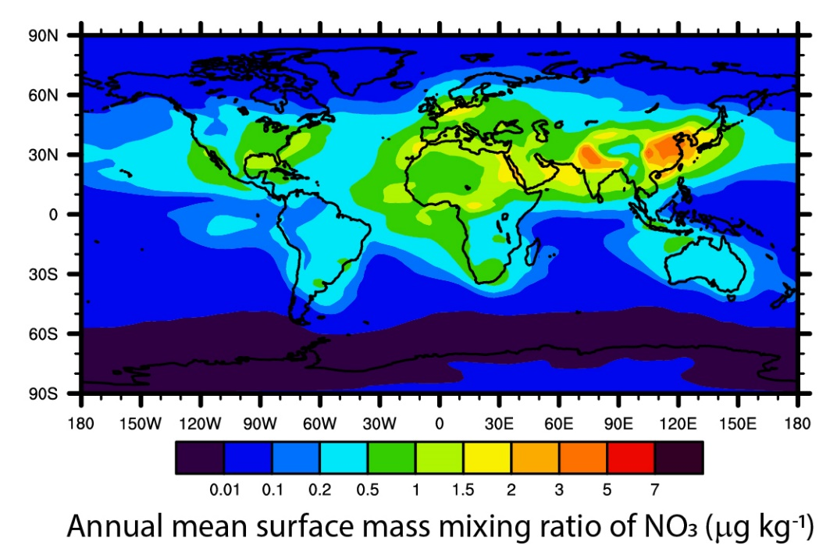
Simulating the Global Distribution and Climate Impacts of Nitrate Aerosol
Objective
Determine the global distribution and evaluate the radiative effects of nitrate aerosols.
Approach
Introduce the Model for Simulating Aerosol Interactions and Chemistry (MOSAIC) into the Community Atmosphere Model, version 5 (CAM5).
Apply the model for the time period from 1995 to 2005 that has prescribed historical climatological conditions to simulate global distributions of nitrate aerosol.
Calculate the change in the annual mean top of the atmosphere radiative flux of simulations due to the presence of nitrate aerosols.
Impact
Nitrate formation results in about 10% higher global average number concentrations of accumulation mode aerosols, leading to an about −0.7 W m⁻² cooling effect that partially offsets greenhouse gas warming.
The new model will enable more accurate predictions of nitrate aerosol formation from various pollution sources across the world and its influence on climate change.
The advanced climate model CAM5-Chem-MAM7-MOSAIC provides the modeling community a new tool to reliably simulate global distributions and radiative effects of nitrate as well as other naturally occurring and anthropogenically induced aerosols. The map shows the highest formation of nitrate aerosol above China and India, nations with significant industrial activities.
R. A. Zaveri, R. C. Easter, B. Singh, H. Wang, Z. Lu, S. Tilmes, L. K. Emmons, F. Vitt,
R. Zhang, X. Liu, S. J. Ghan, and P. J. Rasch. “Development and Evaluation of Chemistry-Aerosol-Climate Model CAM5-Chem-MAM7-MOSAIC: Global Atmospheric Distribution and Radiative Effects of Nitrate Aerosol,” Journal of Advances in Modeling Earth Systems, 13, e2020MS002346, (2021). [DOI:10.1029/2020MS002346]
Notes:
http://www.pnnl.gov/science/highlights/highlights.asp?division=749

