Slide 1
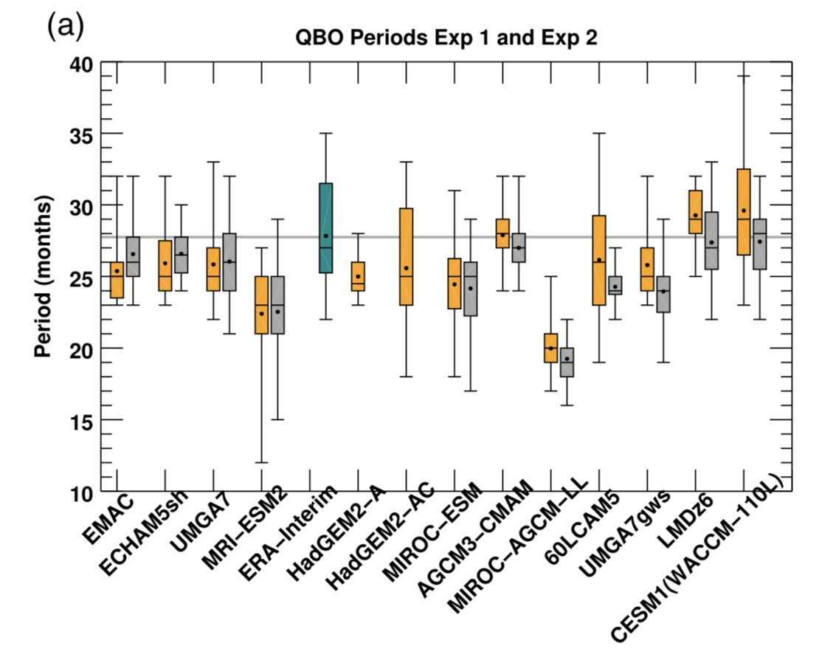
Evaluation of the Quasi-Biennial Oscillation in global climate models for the SPARC QBO-initiative
A. C. Bushell, J. A. Anstey, N. Butchart, Y. Kawatani, S. M. Osprey, J. H. Richter and Others (2020): Quarterly Journal of the Royal Meteorological Society: Special Section QBO Modelling Intercomparison. https://doi.org/10.1002/qj.3765
OBJECTIVE
The quasi-biennial oscillation (QBO) of the tropical stratospheric winds is evaluated in thirteen atmosphere only general circulation models.
APPROACH
Thirteen atmosphere general circulation models have performed simulations with observed (Exp 1) and annually repeating sea surface temperatures (Exp 2).
IMPACT
Models participating in QBOi in general reproduce well the observed QBO period and amplitude at 10 hPa. However, other metrics, such as meridional structure, and amplitudes at and below 50 hPa need improvement.
Characteristics of the QBO are very similar whether or not the prescribed SSTs vary interannually. Mean QBO periods and variability are more sensitive to SSTs in models with parameterized gravity wave sources.
Distribution of QBO periods for QBOi Exp 1 (Yellow, observed SSTs), and Exp 2 (Grey, climatological SSTs). ERAi is shown in green.

