Slide 1
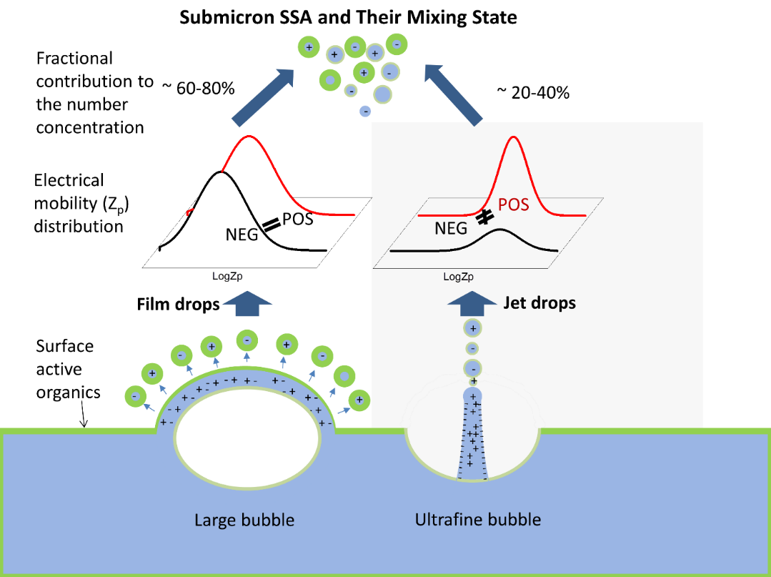
Sea Spray Particles: Same Water, Different Chemistry
Objective
Separate sea spray particles produced from film drops and jet drops, and identify chemical and physical differences
Approach
Produce a distribution of bubbles through the electrolysis of seawater
Quantify the relative contributions of jet and film drops to total submicrometer sea spray particles
Impact
Jet drops formed from ocean bubbles contribute a larger fraction of small sea spray particles than previously thought
Film drops more efficiently transfer total organic matter, while jet drops more efficiently transfer ice-nucleating particles
Earth system models will need to distinguish between jet and film drops to accurately represent both the cloud- and ice-nucleating particles emitted in sea spray
Sea spray particles in the atmosphere are produced from film drops or jet drops. The graph shows that while film drops (black dots) contain a greater proportion of organic matter than jet drops (blue squares), jet drops are larger.
Wang X, GB Deane, KA Moore, OS Ryder, MD Stokes, CM Beall, DB Collins, MV Santander, SM Burrows, CM Sultana, and KA Prather. 2017. “The Role of Jet and Film Drops in Controlling the Mixing State of Submicron Sea Spray Aerosol Particles.” Proceedings of the National Academy of Sciences 114(27):6978-6983. DOI: 10.1073/pnas.1702420114
Notes:
http://www.pnnl.gov/science/highlights/highlights.asp?division=749

