Slide 1
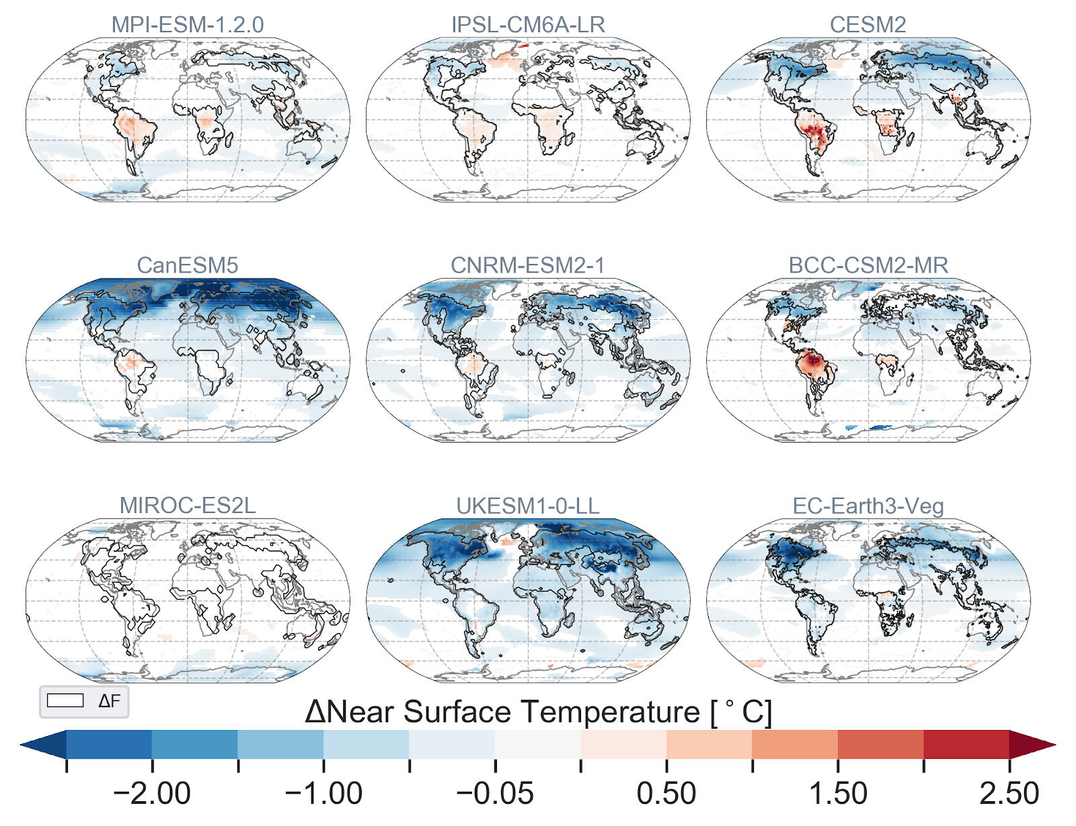
Climate response to Idealized Deforestation
deforest-globe: Remove 20 million km² of forest over 50 years from top 20% forested cells
Broad agreement of cooling across boreal forests
Most (but not all) models show warming in the Tropics
Boysen, L., V. Brovkin, J. Pongratz, D. Lawrence, et al., 2020. Global climate response to idealized deforestation in CMIP6 models. Biogeosciences, doi.org/10.5194/bg-17-5615-2020.

