Slide 1
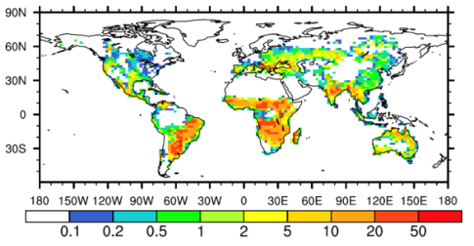
Fire Affects Global Land Temperatures and
Energy Flows by Restructuring Ecosystems
Objective
Understand fire’s influence on the global annual land surface air temperature and energy budget in the 20th century
Approach
Evaluate Community Earth System Model (CESM) fire performance relative to different 20th century fire data sets
Compare “fire-on” and “fire-off” model simulations in different biomes, particularly focusing on tropical savannas and other fire-prone areas of the world
Impact
Fire increases surface air temperature predominantly by reducing latent heat flux, mainly due to fire-induced damage to the vegetation canopy
This study provides an integrated estimate of fire and the changes it induces in ecosystems, land temperatures, and the energy budget at a global scale
The figure shows the annual burned area fraction averaged over the 20th century as computed by the Community Earth System Model. Simulations showed the highest burned area fractions in tropical savannas and southern Asia.
F Li, DM Lawrence, and B Bond-Lamberty. 2017. “Impact of Fire on Global Land Surface Air Temperature and Energy Budget for the 20th Century due to Changes within Ecosystems.” Environmental Research Letters 12:044014. DOI: 10.1088/1748-9326/aa6685
Notes:
http://www.pnnl.gov/science/highlights/highlights.asp?division=749

