Slide 1
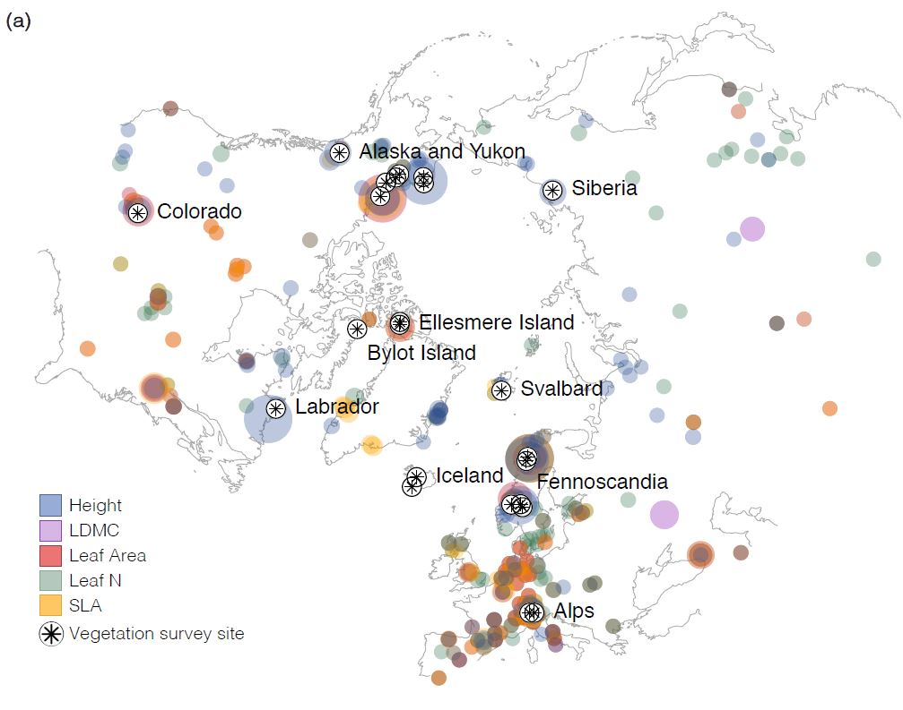
Change in Plant Functional Traits Across a Warming Tundra Biome
Objective
Understand how Arctic and alpine plants’ structure and function vary over time and space
Approach
Integrate more than 56,000 trait observations with nearly three decades of plant community vegetation surveys at 117 Arctic and alpine tundra sites spanning the Northern Hemisphere
Examine how plant traits vary in space and time, as well as their links to factors such as temperature and soil moisture
Impact
Over nearly three decades (1989−2015), community plant height increased with warming across all sites, but other traits lagged far behind rates of change predicted from spatial temperature-trait relationships
Findings highlight the challenge of using space-for-time substitution to predict the effects of future warming
Results will enable improved model projections of tundra functional change with warming temperatures
This map shows vegetation survey sites and tundra trait records studied, including height, leaf dry matter content (LDMC), leaf area, leaf nitrogen content (leaf N), and specific leaf area (SLA). Larger circles indicate that more measurements of that trait were available at a given location.
Bjorkman AD et al. 2018. “Change in Plant Functional Traits Across a Warming Tundra Biome.” Nature 562:57-62, https://www.nature.com/articles/s41586-018-0563-7.
Notes:
http://www.pnnl.gov/science/highlights/highlights.asp?division=749

