Slide 1
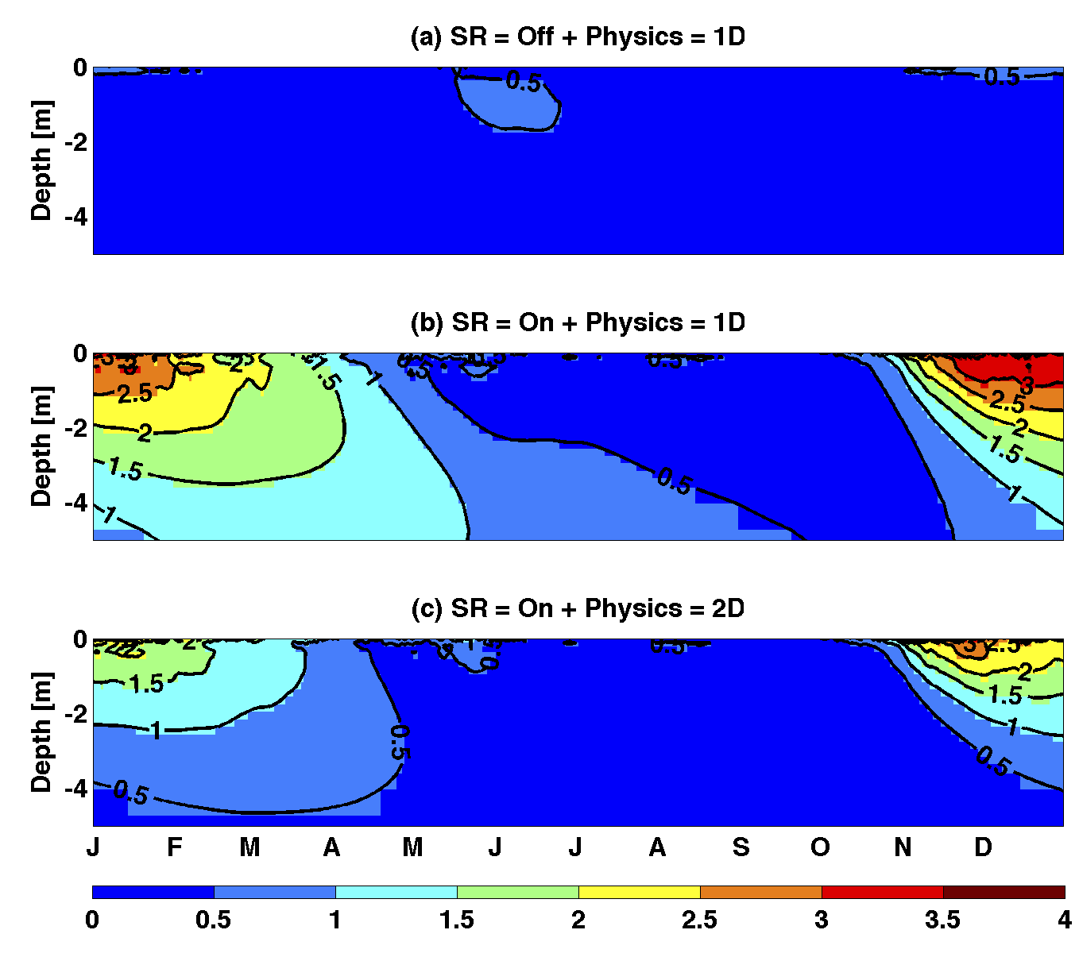
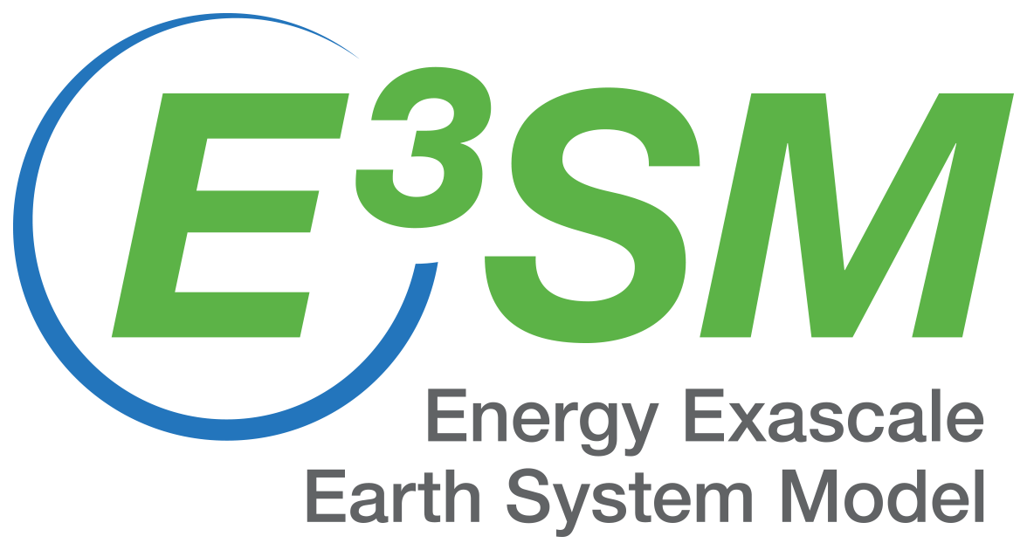
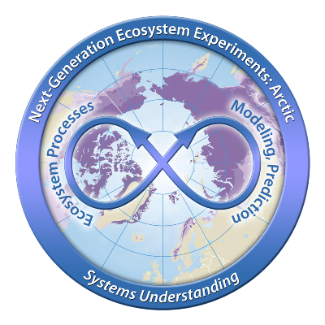
Impacts of microtopographic snow-redistribution and lateral subsurface processes in an Arctic polygonal ecosystem
We analyze the effects of snow redistribution (SR) and lateral subsurface processes on hydrologic and thermal states at a polygonal tundra site near Barrow, Alaska.
Spatial heterogeneity of snow depth during the winter due to SR generated surface soil temperature heterogeneity that propagated in depth and time. Excluding lateral subsurface processes led to an overestimation of spatial variability in soil temperature.
[K]
Vertical profile of simulated daily spatial standard deviation of soil temperature for simulations performed with (a) SR turned off and 1D physics; (b) SR turned on and 1D physics; and (c) SR turned on and 2D physics.
E3SM Land model was extended to include:
  Redistribution of incoming snow to account for microtopography
  Lateral redistribution of soil moisture and soil temperature
The model successfully reproduced observed soil temperature vertical profiles in polygon rims and centers
Citation: Bisht, G., Riley, W. J., Wainwright, H. M., Dafflon, B., Fengming, Y., and Romanovsky, V. E.: Impacts of microtopographic snow redistribution and lateral subsurface processes on hydrologic and thermal states in an Arctic polygonal ground ecosystem: a case study using ELM-3D v1.0, Geosci. Model Dev., 11, 61-76, https://doi.org/10.5194/gmd-11-61-2018, 2018

