Slide 1
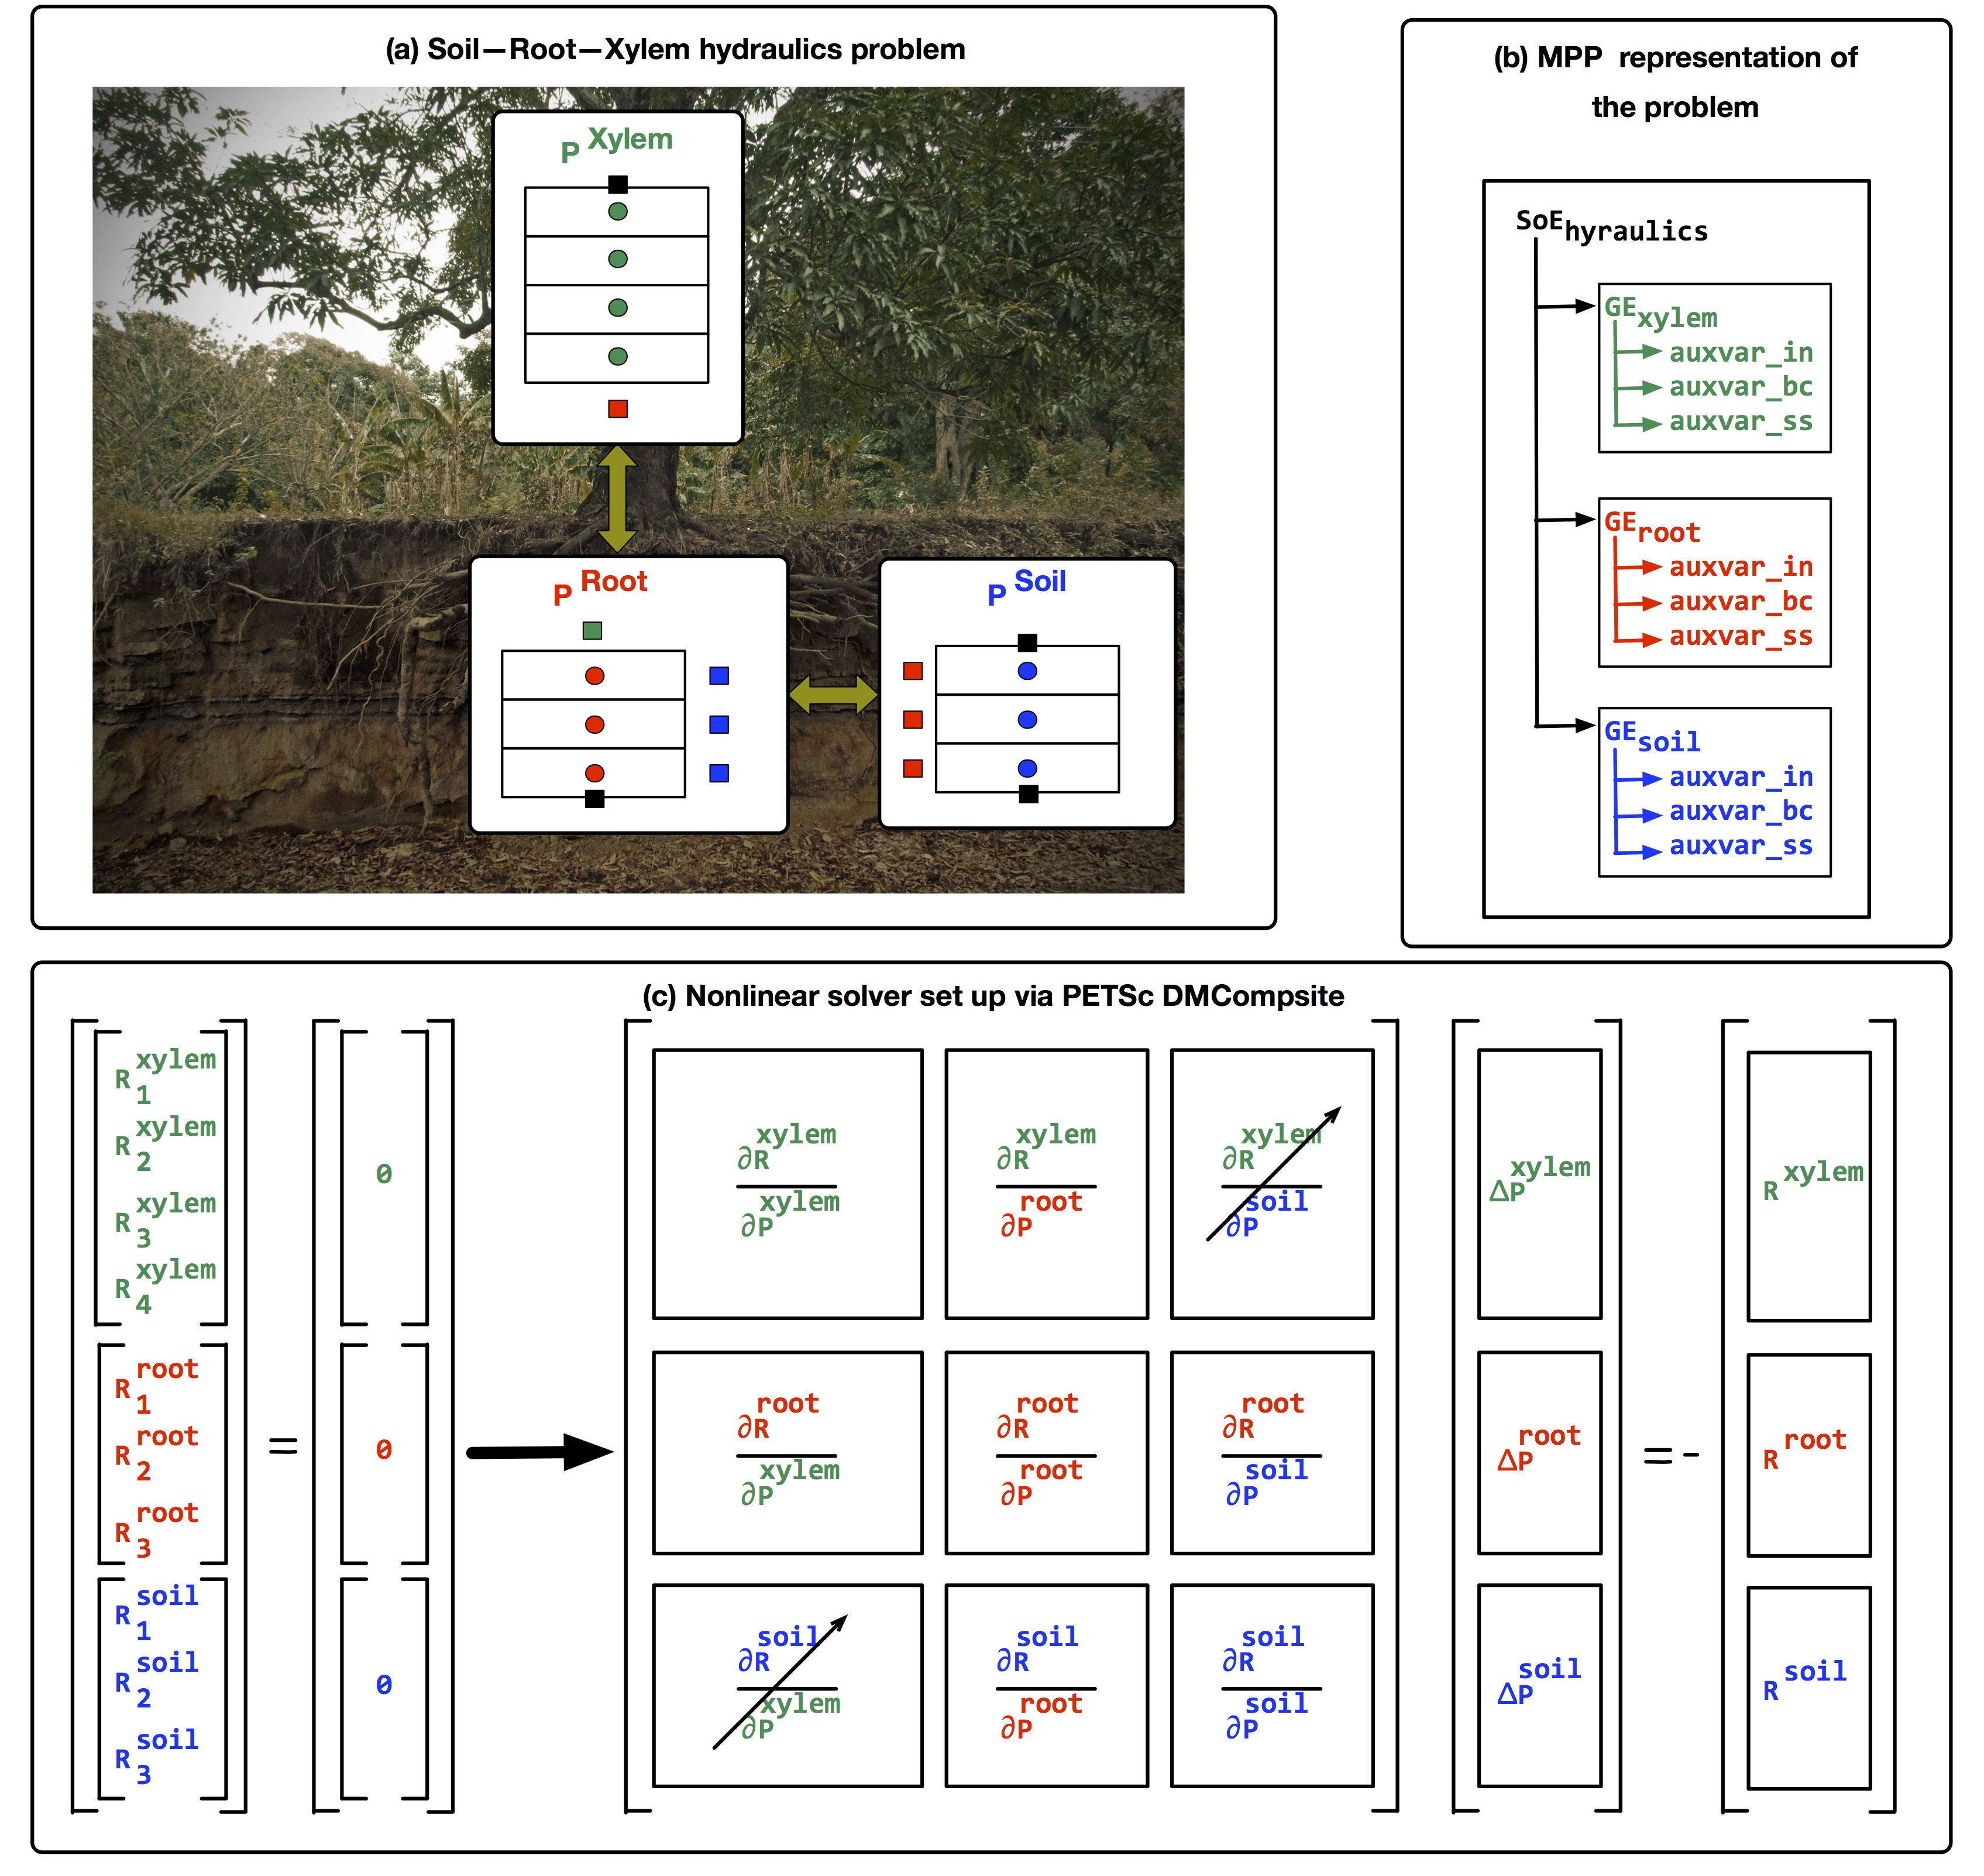

Model verification in ELMv1 of soil and plant hydraulics and thermal advection and diffusion
Developed a numerically robust standalone Multi-Physics Problem (MPP) library for solving terrestrial processes at global scales with support for flexible coupling strategies
The MPP library is coupled to ELMv1 and can be used for solving soil hydrologic and thermal processes
This work provides an example of incorporating code verification as an integral part of ELM development to build confidence in the numerical implementation of the model.
A standalone, open source numerical library for solving terrestrial processes at global scales was developed and integrated in the E3SM Land Model ELM
The Method of Manufactured Solutions (MMS) was used to verify the numerical implantation of multi-physics processes when analytical solutions were unavailable
MMS was applied to a range of problems problems including transport of water through the soil-plant continuum and tightly coupled soil thermal hydrology
Bisht, G., & Riley, W. J. (2019). Development and verification of a numerical library for solving global terrestrial multi‐physics problems. Journal of Advances in Modeling Earth Systems, 11. https://doi.org/10.1029/2018MS001560

