Slide 1
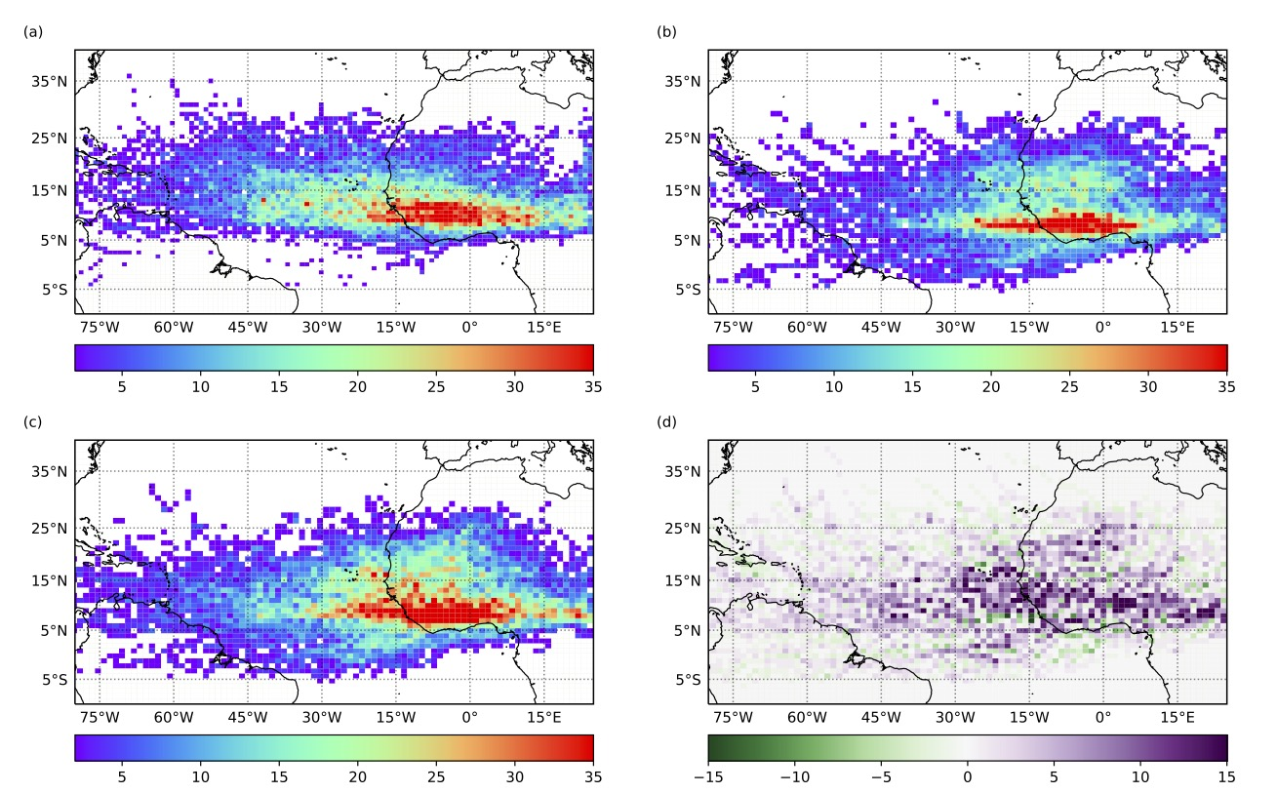
Anthropogenic influences on the African easterly jet – African easterly wave system
Scientific Challenges
African easterly waves (AEWs) can serve as precursors to tropical cyclones that develop in the Atlantic Ocean. It is therefore crucial to understand how the future climate will affect AEWs, specifically with respect to their location and strength, as this will affect tropical cyclone development.
Approach and Results
We used the Weather Research and Forecasting model configured as a tropical channel model to run 10 hindcast simulations and 10 additional simulations as if were the late 21st century. Our results show that in the future climate, there will be an increase in the number and strength of African easterly waves.
Significance
The African easterly jet is weaker and located farther north in the future climate, in association with an increase in precipitation over the Sahel and a strengthening of the meridional temperature gradient.
Future climate change leads to an increase in the number of African easterly waves in the southern and northern wave tracks.
African easterly waves are stronger in the future climate, in association with an increase in the energy conversions.
Count per 150 km box of the May-October 2001-2010 African easterly wave tracks from the (a) ERA5 reanalysis, and the Weather Research and Forecasting tropical channel model (b) historical, (c) late-century, and (d) late-century minus historical.
﻿Bercos-Hickey, E., and C. M. Patricola, 2021: Anthropogenic influences on the African easterly jet–African easterly wave system. Clim. Dyn., doi:10.1007/s00382-021-05838-1.

