Slide 1
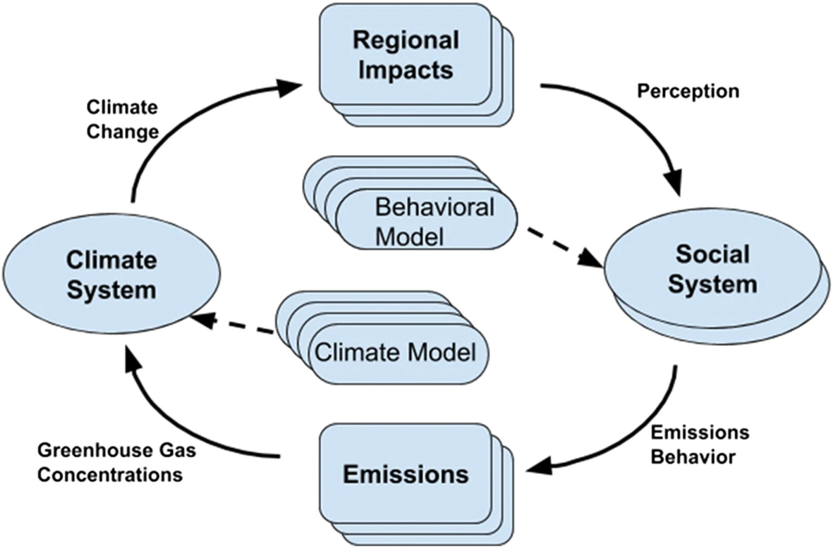
The Earth Has Humans, So Why Don’t Our Climate Models?
Objective: To inspire an interdisciplinary effort to couple models of human behavior and social systems with climate models to overcome deficiencies in representing feedbacks.
Approach: A multi-model approach that considers a range of theories and representations of human perception and behavior, driven by a suite of social factors, is proposed.
Results/Impacts: We describe the importance of linking social factors with climate processes and identify four priorities for advancing the development of coupled social-climate models: 1) evaluate an array of behavioral theories, 2) identify regional climate impacts on humans, 3) incorporate influence of diverse social systems, and 4) improve representation of how perceptions and behavior influence greenhouse gas emissions.
Figure: Schematic diagram demonstrating a strategy for coupling social models with climate models.
Beckage, B., K. Lacasse, J. M. Winter, L. J. Gross, N. Fefferman, Forrest M. Hoffman, S. S. Metcalf, T. Franck, E. Carr, A. Zia, and A. Kinzig (2020), The Earth Has Humans, So Why Don’t Our Climate Models? Clim. Change, doi:10.1007/s10584-020-02897-x.

