Slide 1
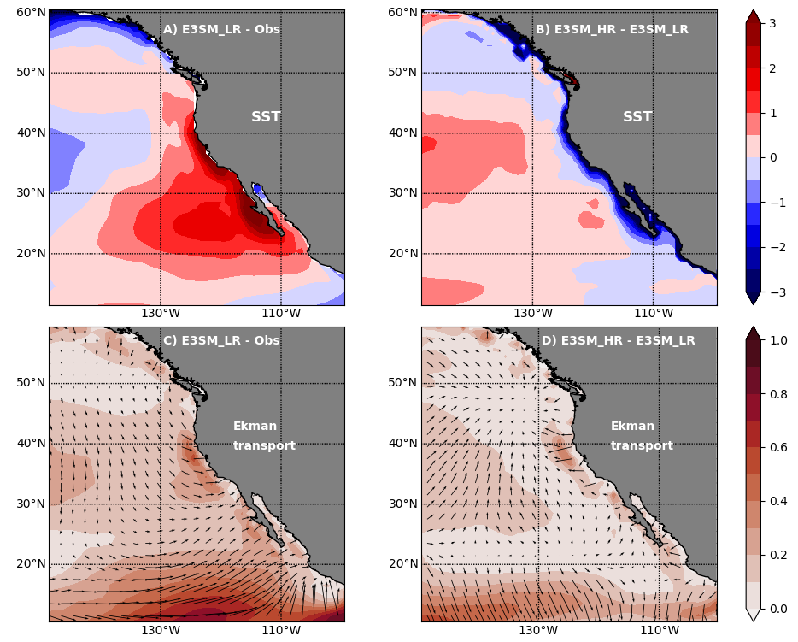
Understanding Climate Model Bias in Subtropical Eastern North Pacific Sea Surface Temperatures
Objective
Understand the mechanisms behind the sea surface temperature (SST) bias in the Subtropical Eastern North Pacific (SENP) using simulations based on the Energy Exascale Earth System Model (E3SM).
Approach
Use fully-coupled E3SM simulations at low (E3SM_LR: 1° atmosphere, 0.4° ocean) and high resolutions (E3SM_HR: 0.25° atmosphere, 0.1° ocean), and uncoupled E3SM (ocean-only and atmosphere-only ) simulations.
Perform an analysis of various coastal processes and the mixed layer heat budget.
Analyze Coupled Model Intercomparison Project Phase 6 models to determine the generalizability of the E3SM results.
Impact
The coastal SST bias is lower in E3SM_HR; however, the SENP SST bias farther from the coast is less affected by changes in model resolution.
Meridional winds along the coast, stratus clouds, and large-scale circulation are identified as sources of model biases.
The impact of resolution on the SENP SST bias observed in E3SM can also be found in other models, with implications for SST biases in other subtropical regions.
A) Annual mean SST (ºC) bias in E3SM_LR. B) The difference in annual mean SST between E3SM_HR and E3SM_LR. C-D) The same as in A-B but for Ekman transport (m²s⁻¹). In panels C and D, the color in the background represents the magnitude of vector differences.
K. Balaguru, L. P. Van Roekel, L. R. Leung, and M. Veneziani. ”Subtropical Eastern North Pacific SST bias in earth system models.” Journal of Geophysical Research: Oceans, 126, e2021JC017359, (2021). [DOI: 10.1029/2021JC017359]
Notes:
http://www.pnnl.gov/science/highlights/highlights.asp?division=749

