Slide 1
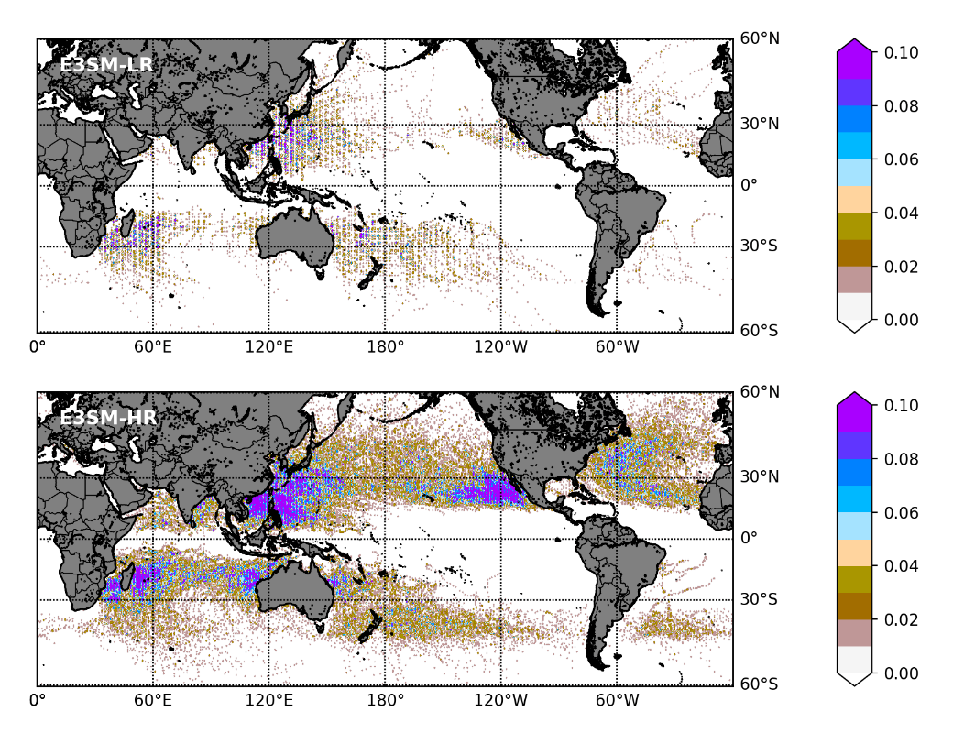
Characterizing Tropical Cyclones in the Energy Exascale Earth System Model version 1
Objective
Understand and evaluate the simulation of tropical cyclones (TCs) in the Energy Exascale Earth System Model version 1 (E3SM).
Approach
Analyze TCs in fully coupled E3SM simulations standard (1º atmosphere) and high (0.25º atmosphere) resolutions.
Understand errors in model TC characteristics, such as the spatial distribution of tracks and intensity based on those of the simulated TC environment.
Impact
Compared to standard resolution, the simulation accuracy of TC characteristics, such as frequency and lifetime maximum intensity, improve considerably in the high-resolution version.
Sea surface cooling in response to TC-induced mixing and the consequent negative feedback on TCs are simulated well in the high-resolution configuration.
At both resolutions, the model produces spurious TC activity in the subtropical southeast Pacific and the south Atlantic, likely due to systematic sea surface temperature biases.
These results suggest that improvements in coupled model biases could alleviate errors in TC simulations.
TC track density, defined as the number of track locations determined at 6-hour intervals in a specific area per year, from the low- (E3SM-LR) and high-resolution (E3SM-HR) simulations. The distribution of TC tracks improves significantly in the high-resolution version of the model globally.
Balaguru, K., Leung, L. R., Van Roekel, L., Golaz, J.‐C., Ullrich, P., Caldwell, P. M., et al. (2020). Characterizing Tropical Cyclones in the Energy Exascale Earth System Model version 1. Journal of Advances in Modeling Earth Systems, 12, e2019MS002024. https://doi.org/10.1029/2019MS002024
Notes:
http://www.pnnl.gov/science/highlights/highlights.asp?division=749

