Slide 1
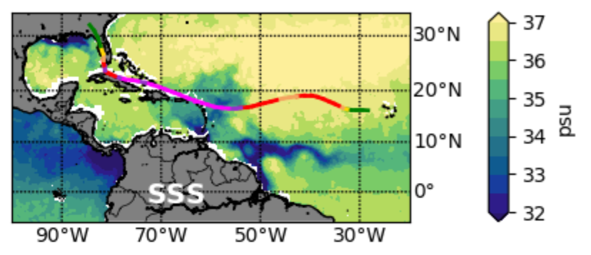
Pronounced Impact of Salinity on Rapidly Intensifying Tropical Cyclones
Objective
Explore the potential role of salinity in the rapid intensification of Atlantic tropical cyclones
Approach
Analyzed a suite of observations, including reanalysis datasets and several satellite data products
Performed experiments with a one-dimensional ocean mixed layer model, initialized with Argo vertical ocean temperature and salinity profiles and subjected to hurricane winds, to isolate the role of salinity in rapid intensification
Used a statistical classification algorithm to test the value of including ocean surface salinity for rapid intensification prediction
Impact
In the western subregion of the western tropical Atlantic, upper-ocean heat content is important for rapid intensification
In the eastern subregion, ocean density and salinity stratification are significantly more important for rapid intensification
Experiments with a statistical classification scheme suggest that the use of salinity will likely improve rapid intensification forecasts, which is one of the greatest challenges faced by operational hurricane forecasters
Sea surface salinity (psu) from satellite data averaged between 19 and 27 August 2017 overlaid with the track of Tropical Cyclone Irma, color-coded by the storm’s intensity. The periods of rapid intensification to Cat 4 and 5 correspond with lower sea surface salinity measurements.
Balaguru K, GR Foltz, LR Leung, J Kaplan, W Xu, N Reul and B Chapron. 2020. “Pronounced impact of salinity on rapidly intensifying tropical cyclones.” Bulletin of the American Meteorological Society in press.
DOI: 10.1175/BAMS-D-19-0303.1

