Slide 1
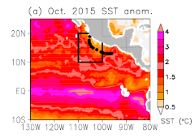
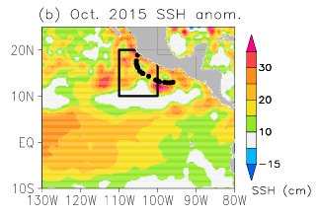
Prolonged El Niño Conditions Led to Rapid Intensification of 2015’s Hurricane Patricia
Objective
Examine prevailing oceanic conditions during Hurricane Patricia, the strongest western hemisphere hurricane in recorded history, and to understand their significance for its intensification.
Analyze the potential causes for the oceanic state that resulted in Hurricane Patricia’s extraordinary intensity.
Approach
Examine the role of sub-surface oceanic conditions, including salinity, in the intensification of Hurricane Patricia using the framework of Dynamic Potential Intensity.
Use satellite sea-level altimeter data to understand the evolution of the 2015 El Niño.
Perform a mixed layer heat budget analysis for the Hurricane Patricia region using monthly sea-surface temperature, surface ocean currents and air-sea flux data.
October 2015 anomalies (with respect to 1993–2014 monthly mean climatologies) of (left) satellite in situ SST and (right) satellite SSH. Black circles indicate 6-hourly track locations of Patricia, and black boxes indicate the study region.
Impact
The warming of the upper-ocean and the deepening of the thermocline along with enhanced salinity stratification due to the discharge from Rio de Grande and Balsas Rivers reduced the vertical mixing and sea surface cooling for Hurricane Patricia and enhanced its intensity.
Persistent El Niño conditions beginning in 2014 caused the heat build-up in the eastern Pacific where Hurricane Patricia intensified.
Understanding the concurrent heat content and salinity conditions of the oceans is important for improving hurricane forecasting.
Foltz GR and K Balaguru. 2016. “Prolonged El Niño conditions in 2014-2015 and the rapid intensification of Hurricane Patricia in the eastern Pacific.” Geophysical Research Letters 43:10347–10355. DOI:10.1002/GL2016070274
Notes:
http://www.pnnl.gov/science/highlights/highlights.asp?division=749

