Slide 1
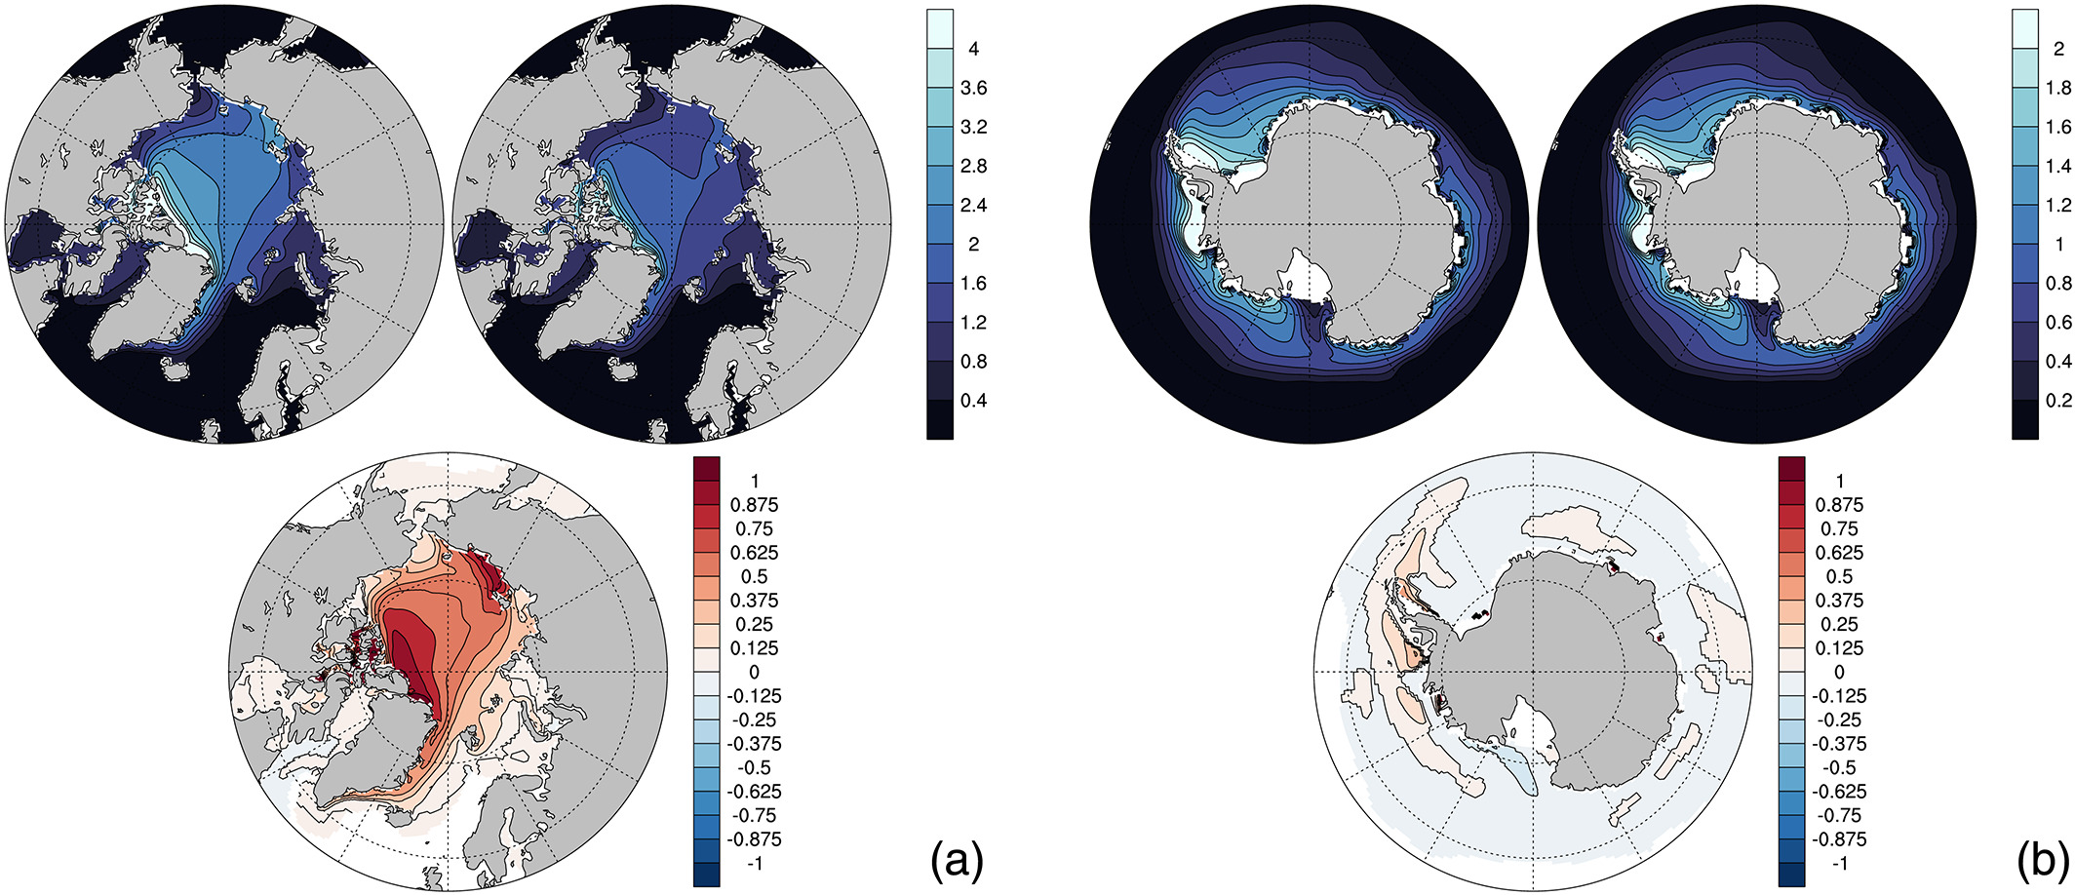
Impact of a New Sea Ice Thermodynamic Formulation in the CESM2 Sea Ice Component
Objective: To investigate the role of a new approach for sea ice thermodynamics in the Community Earth System Model, based on mushy‐layer theory.
Approach:
Compare fully coupled CESM2 simulations using two different thermodynamics approaches: the new, LANL-developed “mushy-layer” scheme that predicts salinity within the sea ice, and the older “Bitz and Lipscomb” (BL99) scheme that uses a fixed salinity profile.
Results:
The mushy-layer scheme produces thicker, more extensive ice in both hemispheres relative to the BL99 thermodynamics used in earlier CESM versions.
The primary factor producing the difference is the fraction of snow on the sea ice.
Despite thicker sea ice in the mushy run, the impacts on the rest of the coupled system are relatively minor, with small differences in the surface air temperature over the sea ice and the sea surface salinity and temperature.
Figure: Mean annual (over the 50 years) sea ice thickness (m) and differences for (a) NH and (b) SH. MUSHY is top left and BL99 is top right. Differences, at bottom center, show MUSHY‐BL99 and are only shown where significant at the 5% level.
Impact: Changes in the thermodynamics and resulting ice state due to the new physical parameterization for thermodynamics modify the simulated ice‐ocean‐ atmosphere fluxes in the fully coupled CESM2 model, with impacts on the atmosphere and ocean states, particularly temperature, which then feed back on the sea ice in the coupled system.
Bailey, D. A., Holland, M. M., DuVivier, A. K., Hunke, E. C., & Turner, A. K. (2020). Impact of a new sea ice thermodynamic formulation in the CESM2 sea ice component. JAMES, 12, e2020MS002154. https://doi.org/10.1029/2020MS002154
Notes:
Wanda says that this is a general slide with no specific reference

