Slide 1
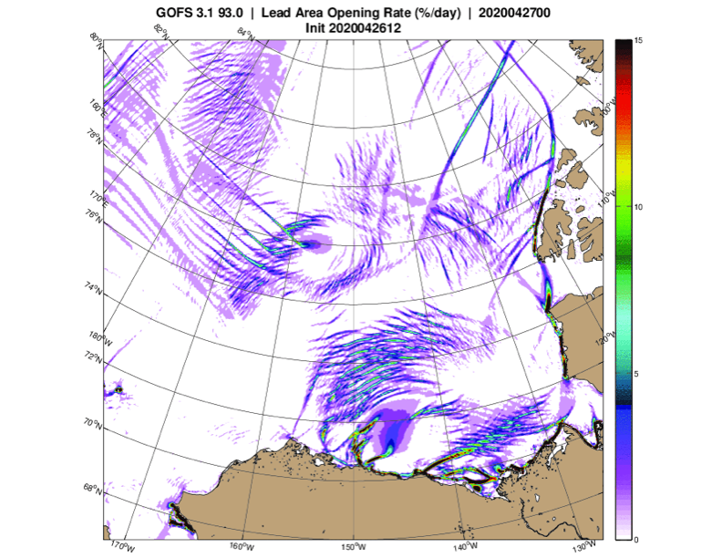
Should Sea-Ice Modeling Tools Designed for Climate Research Be Used for Short-Term Forecasting?
Objective: The desire to understand and predict sea ice raises the question of whether more complex models—which incorporate a larger number and greater fusion of environmental processes and physics—can address the many concerns of both research and operational forecasting user communities. This paper¹ sheds light on the challenges and opportunities of employing complex sea-ice models for short-term forecasting.
Figure: 12-hour forecast of sea-ice opening rates (percent per day) associated with divergence and shear from the U.S. Navy ocean-ice model GOFS-3.1. Figure courtesy of Richard Allard of the U.S. Naval Research Laboratory at NASA’s Stennis Space Center.
Approach:
Engage sea ice modelers in a DOE/BER/EESM-supported international workshop²
Workshop participants and co-authors^{1,2} included developers of sea ice models, users of sea ice models in an Earth system modeling context, and users of sea ice models for operational forecasting and (re)analyses
Focus discussion on physical processes and complexity needed to bridge the gap between weather and climate modeling requirements
Disseminate conclusions through peer review¹ and online^{2, 3}
Conclusions:
Continuum models remain a useful tool for sea ice simulation
Discrete element modeling is a promising avenue for the future
A large spectrum of model complexity is warranted
HPC requirements cause uncertainty for future sea ice code structure, optimization
Community involvement plays an important role for sea ice model development
¹Hunke, E., Allard, R., Blain, P. et al., 2020: Should Sea-Ice Modeling Tools Designed for Climate Research Be Used for Short-Term Forecasting? Curr. Clim. Change Rep. https://doi.org/10.1007/s40641-020-00162-y
²Blockley, E., and Coauthors, 2020: The Future of Sea Ice Modeling: Where Do We Go from Here? Bull. Amer. Meteor. Soc., 101, E1304–E1311, https://doi.org/10.1175/BAMS-D-20-0073.1.
³Hunke, E., The Challenges and Opportunities of One-size-fits-all Sea-ice Models. SIAM News, 27 October 2020. https://sinews.siam.org/Details-Page/the-challenges-and-opportunities-of-one-size-fits-all-sea-ice-models
Recommendations:
Implement a flexible framework that enables knowledge and code sharing among research and forecasting centers
Create an international benchmarking product for model comparisons and forecasts
Notes:
Wanda says that this is a general slide with no specific reference

