Slide 1
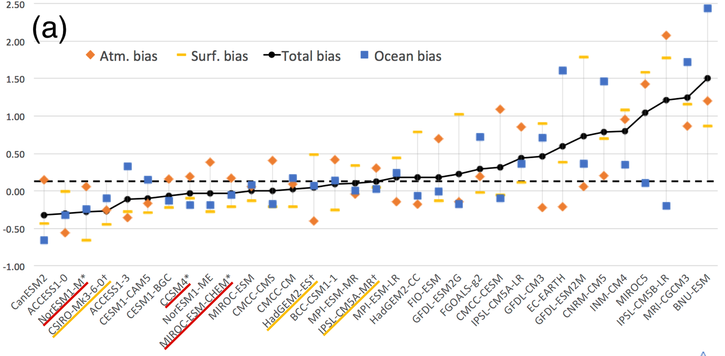
Selecting Climate Forcing to Compare Ice Sheet Models
Objective
Evaluate CMIP5 models near the Greenland / Antarctic ice sheets in support of the Ice Sheet Model Intercomparison Project (ISMIP6).
Climate model evaluation near Antarctica (historical)
Approach
Thirty-three climate models were evaluated near the Antarctic and Greenland ice sheets. The ensemble of models recommended should:
present plausible climates near the ice sheet (evaluated by model biases over the historical period)
sample a diversity of forcing (evaluated by differences in projections and code similarities).
Impact
The selected models are used to derive atmospheric and ocean forcing for the Ice-Sheet Model Intercomparison project (ISMIP), which aims to improve sea level projections, and to which ~16 modeling centers have contributed.
Barthel, A., Agosta, C., Little, C., Hattermann, T., Jourdain, N., Goelzer, H., Nowicki, S., Seroussi, H., Straneo, F. & Bracegirdle, T. CMIP5 model selection for ISMIP6 ice sheet model forcing: Greenland and Antarctica. The Cryosphere 14, 855-879 (2020). [https://doi.org/10.5194/tc-14-855-2020]

