Slide 1
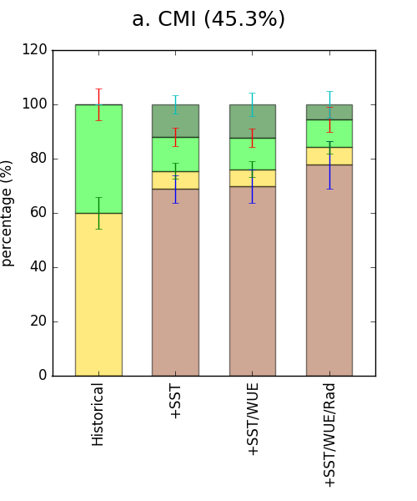
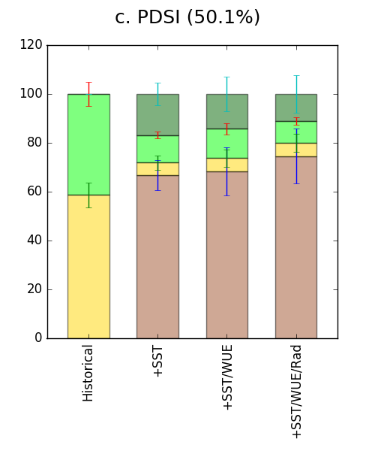
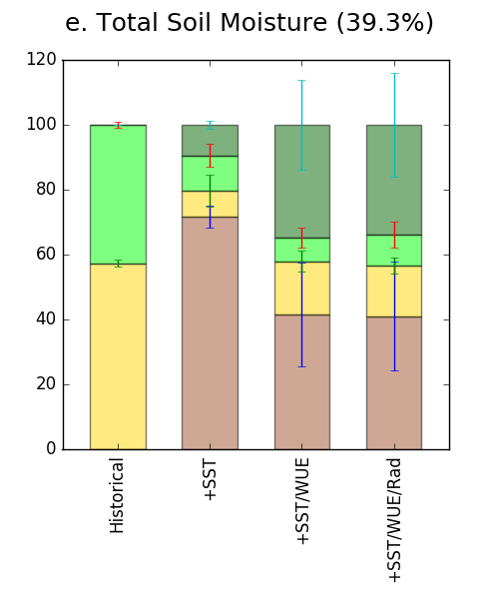
Competing influences on aridity: Present and future
Always wetter
Wetter with El Niño
Drier with El Niño
Always drier
Objective
It is not easy to predict the sign of change in regional aridity. It requires joint investigation of:
the relative contributions from changes in moisture supply (P) vs evaporative demand (PET).
the competing effects of mean changes and ENSO variability to ameliorate or exacerbate drought.
the sensitivity of the physiological and radiative forcings on the results.
+SST
Historical
+SST
+SST
Approach
Use different AMIP experiments 1) to identify regions historically sensitive to ENSO; 2) To determine whether the projected future regional changes in mean aridity exceeds the range of ENSO variability.
Results are examined: 1) when the future climate is driven by a patterned ocean warming (+SST); 2) when plant physiological effects and plant water use are also allowed to respond to rising CO2 (+WUE); 3) when the intensified radiative forcing from enhanced CO2 is also included (+Rad)
Penman-Monteith PET = f(Rad, T, hum, wind, CO₂-invariant stomatal resistance r_{s})
Historical
+SST/WUE
+SST/WUE
Historical
+SST/WUE
+SST/WUE/Rad
+SST/WUE/Rad
+SST/WUE/Rad
Conclusions
1. PET will increase in most currently ENSO-sensitive land regions.
2. P: ∼35-42% of the ENSO-sensitive regions will become drier independent of ENSO phase.
3. Combined: Future aridity will increase in ∼70% of the regions where aridity is currently driven by ENSO variability. It reaches ∼75-78% when the radiative and physiological effects are included. This prediction is much weaker when total soil moisture is considered (41%), due to increased stomatal closure and improved plant water use efficiency.
4. Imposing a CO₂-invariant r_{s} to plants may overestimate future drying in PET-derived indices.
Bonfils, C., G. Anderson, B.D. Santer, T.J. Phillips, K.E. Taylor, M. Cuntz, M.D. Zelinka, K. Marvel, B.I. Cook, I. Cvijanovic, and P.J. Durack, 2017: Competing influences of anthropogenic warming, ENSO, and plant physiology on future terrestrial aridity. J. Climate, in press, doi:10.1175/JCLI-D-17-0005.1 (online)

