Slide 1
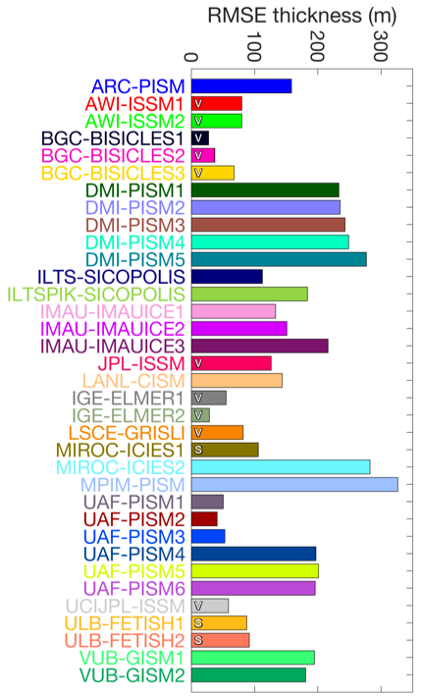
Design and results of the ice sheet model initialisation experiments initMIP-Greenland: an ISMIP6 intercomparison
Objectives
Impact
Compare, evaluate, and improve the initialization techniques used in the ice sheet modelling community
Estimate uncertainties of mass changes in ice sheet models
First ice sheet model intercomparison project that is fully integrated within CMIP
First comparison with no lag in applied climate forcing
Accomplishments
Ice sheet model projections are strongly influenced by the initial sate and this project identified the wide variety of methods and datasets used throughout the ice sheet modeling community
Identifies the initialization methods needed for the 100-200 year ice sheet projections planned for CMIP6
Provides community benchmark to asses new initialization methods
RMSE of initial modeled ice thickness compared to observations for all participating models. Interpretation of the diagnostics requires distinction between the different
initialization techniques, but in general, there is a large impact from the initial state on projected sea level rise of by the model. The CISM model used a spin up technique and BISICLES used a data assimilation of velocity.
Goelzer et al. (2018). “Design and results of the ice sheet model initialisation experiments initMIP-Greenland: an ISMIP6 intercomparison.” DOI: 10.5194/tc-12-1433-2018
Funded by ProSPect BER SciDAC
Notes:
1

Slide 2
LIVVkit: An extensible, python-based, land ice verification and validation toolkit for ice sheet models
Summary
Large scale Greenland ice sheet projections of sea level, such as those run during the ice2sea and SeaRISE initiatives, have shown that the initial state of the Greenland ice sheet used in the model has a large effect on the projected sea level rise, leading to a large uncertainties. The initMIP-Greenland intercomparison exercises allow ice sheet modelers to compare, evaluate and improve their initialization techniques and estimate their associated uncertainties. Two experiments were performed by each modeling group: (1) produce an initial present-day state of the Greenland ice sheet and (2) simulate the response of this initial state in two idealized forward experiments. The forward experiments allow modelers to evaluate the model drift and response to a large perturbation. Though this effort, the initialization methods and datasets have been identified that will be needed for the 100-200 year projections planned for CMIP6. A freely available benchmark dataset has also been generated to help modelers evaluate and improve future initialization methods.
Goelzer, H., Nowicki, S., Edwards, T., Beckley, M., Abe-Ouchi, A., Aschwanden, A., Calov, R., Gagliardini, O., Gillet-Chaulet, F., Golledge, N. R., Gregory, J., Greve, R., Humbert, A., Huybrechts, P., Kennedy, J. H., Larour, E., Lipscomb, W. H., Le clec'h, S., Lee, V., Morlighem, M., Pattyn, F., Payne, A. J., Rodehacke, C., Rckamp, M., Saito, F., Schlegel, N., Seroussi, H., Shepherd, A., Sun, S., van de Wal, R., and Ziemen, F. A.: Design and results of the ice sheet model initialisation experiments initMIP-Greenland: an ISMIP6 intercomparison, The Cryosphere, 12, 1433-1460, 2018. DOI: 10.5194/tc-12-1433-2018
Notes:
2

