Slide 1
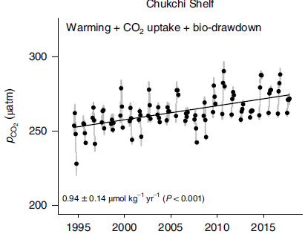
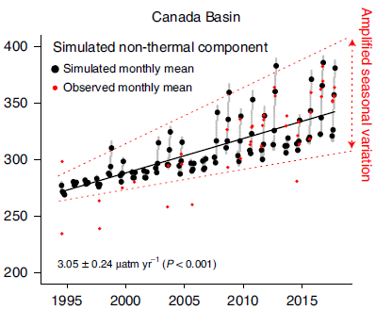
Arctic sea ice loss amplifies decadal CO₂ increase
Why did we do this research?
Understand why the CO₂ in the Arctic Basin has increased much faster than the shelf seas and atmosphere in the last three decades.
Figure: Simulation of sea surface pCO₂ in the Chukchi Shelf and the Canada Basin
How did we conduct the science?
What did we find and why does it matter?
Why do these findings matter?
We use several decades of observations and model results to reveal the underlining mechanism of CO₂ increase due to warming and declining sea ice.
The Arctic Ocean has been considered a potentially large sink of anthropogenic CO₂, but biophysical environment changes has led to quick loss of the capacity in the Canada Basin.
Reference: 5. Ouyang Z., D. Qi, L. Chen, T. Takahashi, W. Zhong, M.D. DeGrandpre, B. Chen, Z. Gao, S. Nishino, A. Murata, Heng Sun, L.L. Robbins, M. Jin, W. Cai, (2020), Sea ice loss amplifies summer-time decadal CO2 increase in the western Arctic Ocean. Nature Climate Change, 10, 678-684, https://doi.org/10.1038/s41558-020-0784-2.

