Slide 1
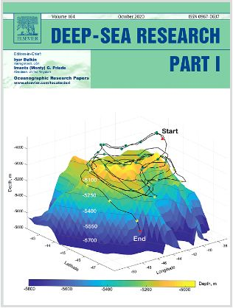
Downward Spiraling Motions in the Zapiola Anticyclone
Objective
We study the pathways of water parcels trapped by the Zapiola Anticyclone – a huge ocean vortex in the Argentine Basin
Research
We use a Lagrangian (particle tracking) method to study the pathway of water parcels in the Zapiola Anticyclone.
We find that water parcels spiral downward: they undergo downward motion while being swept around by the Zapiola Anticyclone.
Water parcels can be trapped for many years, make several revolutions around the center of the vortex, descend hundreds of meters, and experience significant cooling.
Impact
The Argentine Basin is a critical conduit for water masses that are exchanged between the Atlantic and Southern Oceans as part of the global thermohaline circulation.
This is the first study that shows how the Zapiola Anticyclone can affect these water masses.
This study motivates further studies of the impact of the ZA on water masses in the South Atlantic Ocean.
Reference: Weijer, W., Barthel, A., Veneziani, M. and Steiner, H., 2020. The Zapiola Anticyclone: A Lagrangian study of its kinematics in an eddy-permitting ocean model. Deep Sea Research Part I: Oceanographic Research Papers, p.103308. https://doi.org/10.1016/j.dsr.2020.103308
Notes:
Wanda says that this is a general slide with no specific reference

