Slide 1
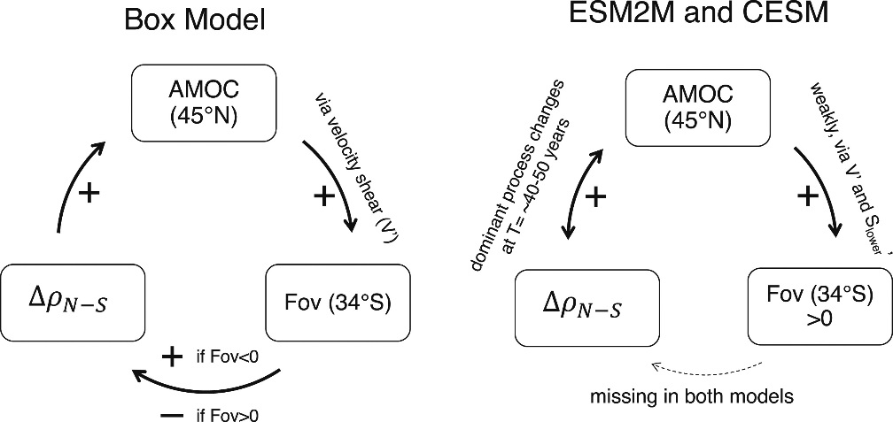
Atlantic Meridional Overturning Circulation and the Salt Advection Feedback
Objective:
The salt advection feedback is a key mechanism controlling AMOC stability
Can we identify elements of the salt advection feedback by analyzing internal AMOC variability in climate models?
Schematic of the elements of the salt advection feedback in box models (left) and how they carry over to comprehensive climate models (right).
Research
The Atlantic Meridional Overturning Circulation (AMOC) is a key player in climate’s heat budget
A collapse would have global consequences
The stability of the AMOC may depend on the freshwater transport it induces in the South Atlantic: salt advection feedback
We use statistical approaches to find evidence for the salt advection feedback in long integrations of CESM1 and ESM2M.
Impact
Internal variability of the AMOC in climate models is too weak to diagnose or activate the salt advection feedback
We cannot infer the key AMOC stability mechanism from control integrations
Internal variability cannot trigger an AMOC collapse
Reference: Cheng, Wei, Wilbert Weijer, Who M. Kim, Gokhan Danabasoglu, Steve G. Yeager, Peter R. Gent, Dongxiao Zhang, John CH Chiang, and Jiaxu Zhang. "Can the Salt-Advection Feedback Be Detected in Internal Variability of the Atlantic Meridional Overturning Circulation?" Journal of Climate 31, no. 16 (2018): 6649-6667.

