Slide 1
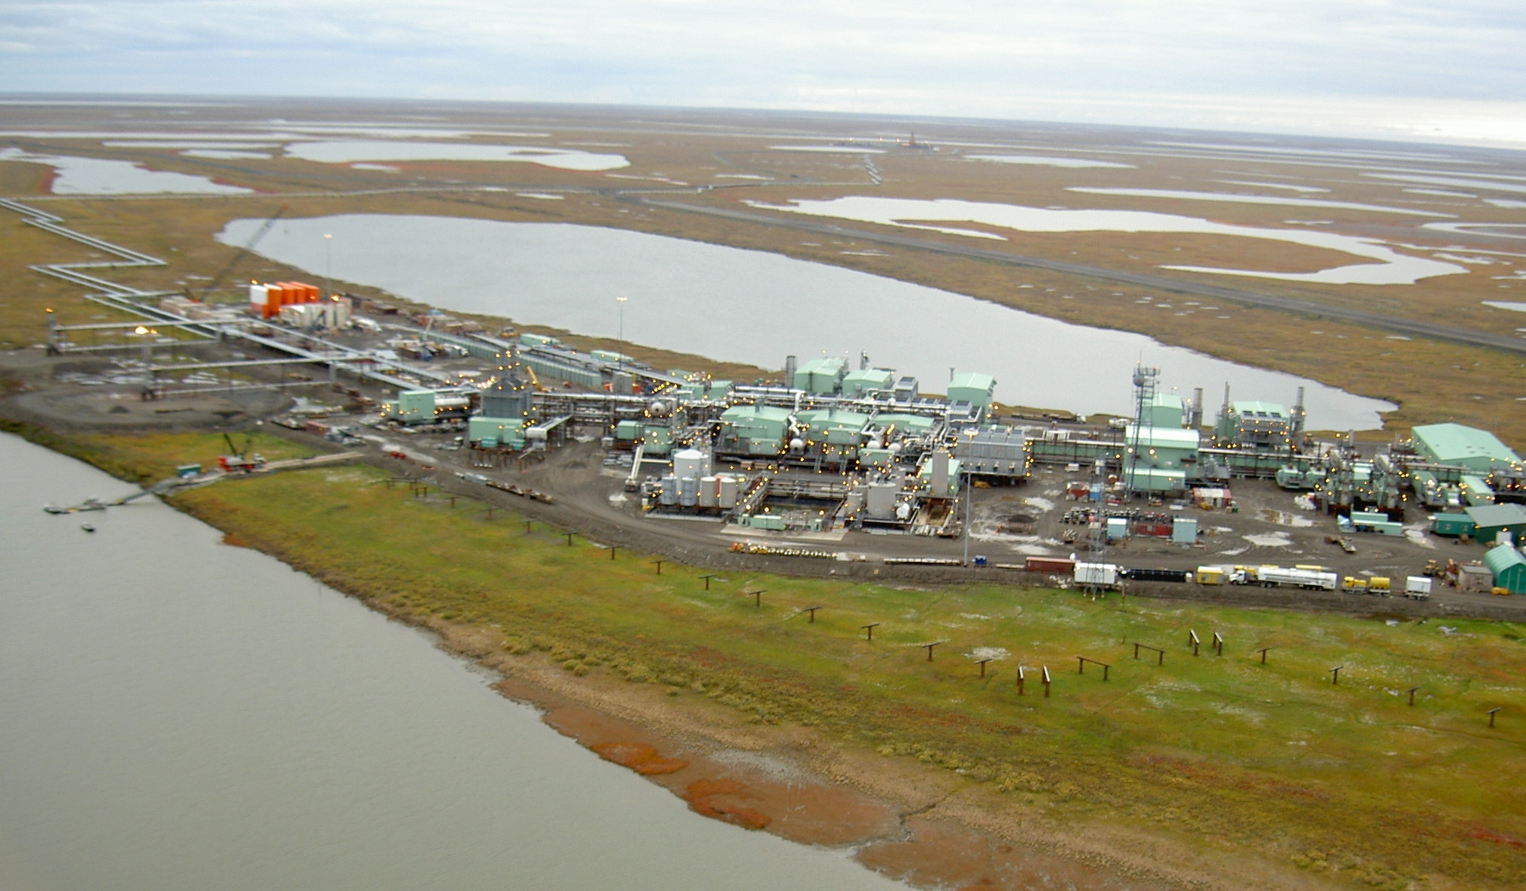
A changing landscape of private investment interests in Arctic oil and gas development
Why did we do this research?
Current trends in private investment policies may affect the future of Arctic oil and gas development. This may influence the scale, and location where oil and gas development occurs.
Arctic oil development infrastructure
How did we conduct the science?
What did we find and why does it matter?
Why do these findings matter?
Identify indicators of large investment bank policies related to Arctic oil and gas development.
Describe national policies that support Arctic oil and gas over the past decade and compare regional differences across the Arctic.
Oil and gas development is an important economic driver in many Arctic states. Understanding the changing landscape of private investments in Arctic oil and gas could change how, and where Arctic development occurs over the next decade.
Reference: Lee, O. 2020. Effect of Corporate Sustainability Policies and Investment Risks for Future Arctic Oil and Gas Development in Alaska. Arctic Yearbook. https://arcticyearbook.com/arctic-yearbook/2020/2020-scholarly-papers/340-effect-of-corporate-sustainability-policies-and-investment-risks-for-future-arctic-oil-and-gas-development-in-alaska

