Slide 1
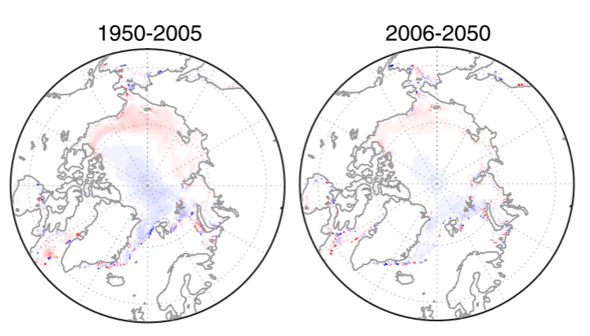
How Does Arctic Sea Ice Growth Respond to Atmospheric Forcing?
Why did we do this research?
Arctic ice is an important component of our climate system.
It is driven by ocean and atmosphere and it is important to understand how sea ice is formed, now and in the future.
Response of the sea ice growth rate to the Arctic Dipole during the historical period (left) and future projections (right)
How did we conduct the science?
Why do these findings matter?
-We explore the response of Arctic sea ice growth to atmospheric forcing using model output of the Coupled Model Intercomparison Project Phase 5 from three models that are successful in reproducing the wintertime Arctic Oscillation and Arctic Dipole patterns.
The three models agree on the weaker response of dynamic sea ice growth rate. This is important in order to understand how the sea ice will interact with the atmosphere in the future.
Reference: Lei Cai, Vladimir A. Alexeev and John E. Walsh, 2020. “Arctic Sea Ice Growth in Response to Synoptic- and Large-Scale Atmospheric Forcing from CMIP5 Models” Journal of Climate 33 (14), DOI: https://doi.org/10.1175/JCLI-D-19-0326.1

