Slide 1
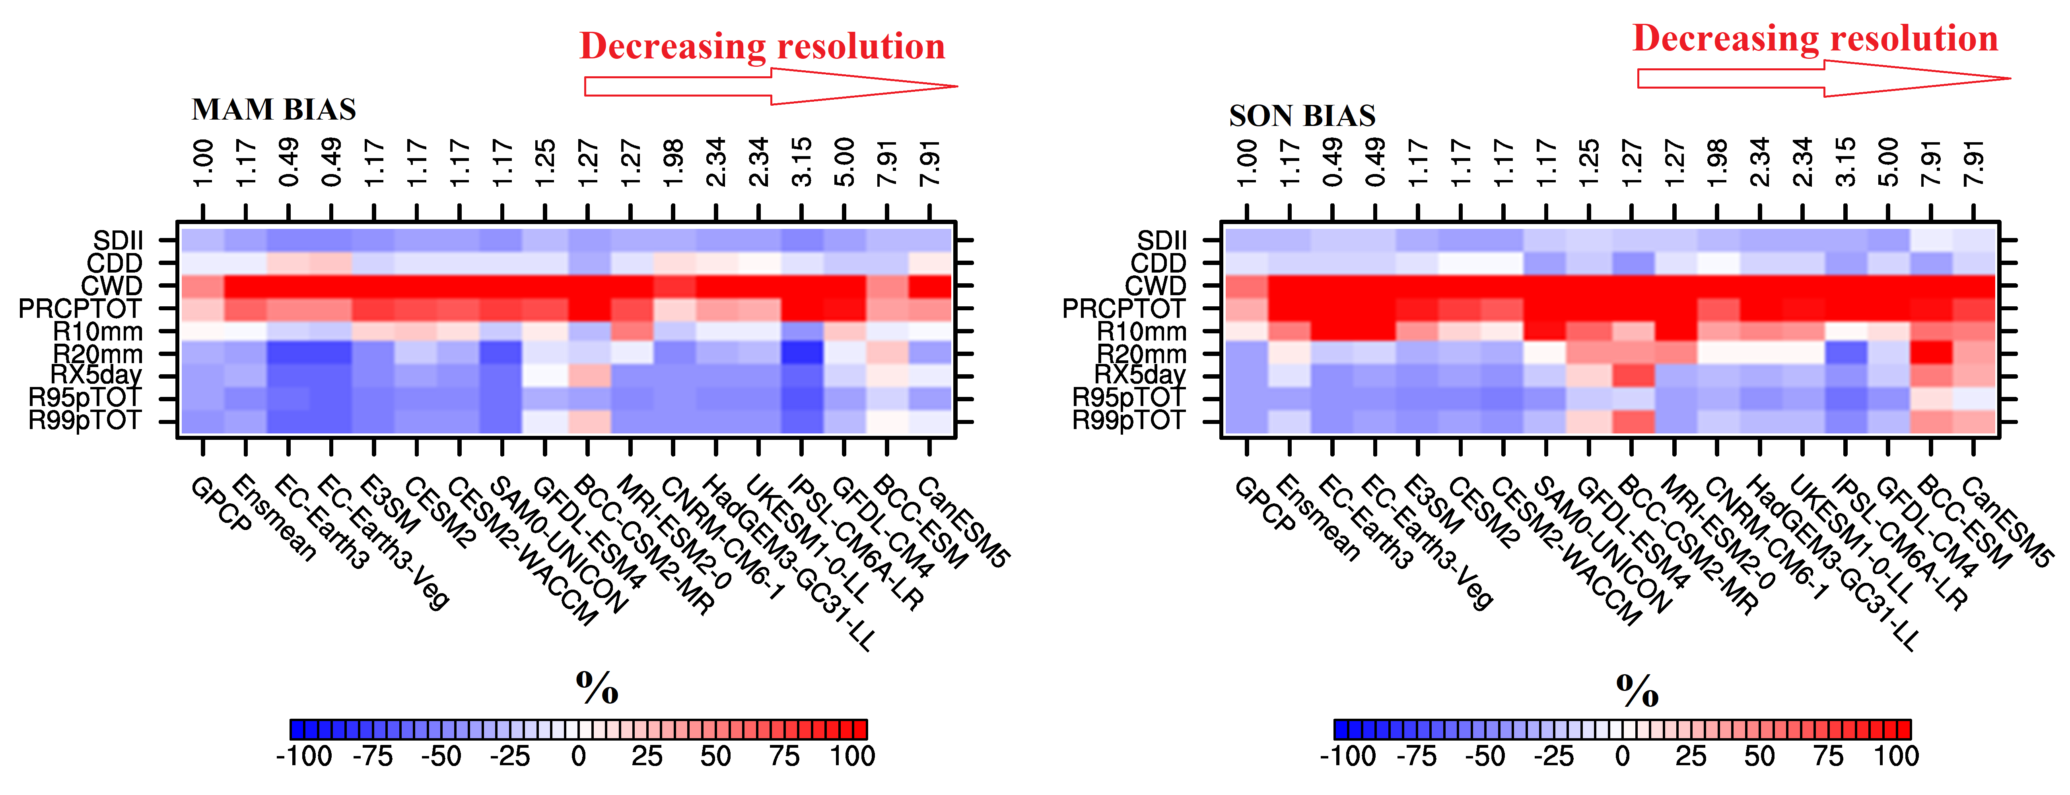
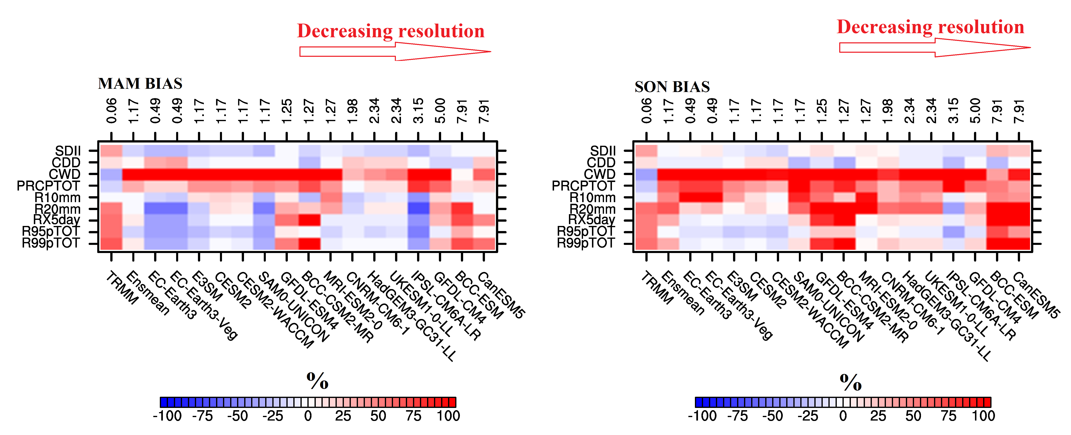
Evaluation of CMIP6 models in simulating the statistics of extreme precipitation over Eastern Africa
Percentage Bias of Extreme Precipitation Indices Relative to TRMM
Objective: Assess how the newly developed Earth system models (i.e CMIP6) represent the present-day statistics of precipitation extremes over Eastern Africa.
Approach: Apply a comprehensive set of nine extreme precipitation indices to evaluate the representation of extreme precipitation against two gridded observational data (TRMM 3B42 and GPCP 1DD).
Results: CMIP6 models overestimate the total-wet day precipitation and maximum consecutive wet days, and underestimate very wet days and maximum 5-day precipitation in both seasons (March–May and September–November). The model performance varies with the season and index, and is generally independent of horizontal resolution.
Percentage Bias of Extreme Precipitation Indices Relative to GPCP
Akinsanola AA, Ongoma V and Kooperman GJ (2021) Evaluation of CMIP6 models in simulating the statistics of extreme precipitation over Eastern Africa. Atmos. Res. 254,105509. https://doi.org/10.1016/j.atmosres.2021.105509.

