Slide 1
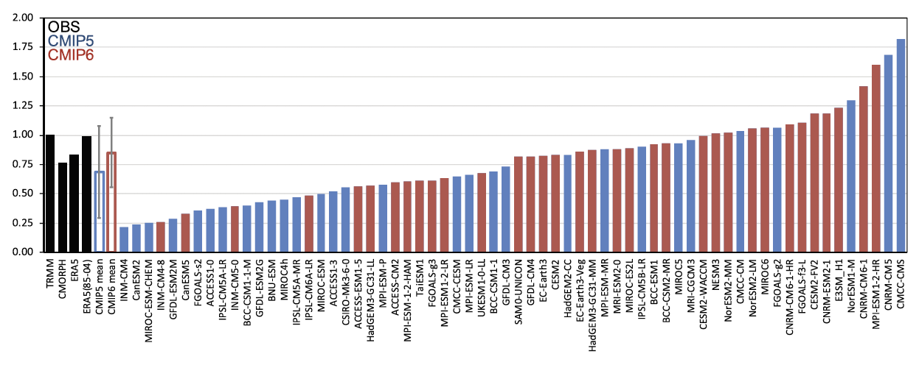

MJO Propagation Across the Maritime Continent
Scientific Achievement
Many contemporary climate models struggle to simulate a realistic Madden-Julian Oscillation (MJO) propagation across the Maritime Continent, and this common bias had persisted over the previous generations of CMIP. We show that, in the newly released CMIP6 models, the simulation of the MJO propagation is significantly improved when compared to CMIP5 models. The improvement in the MJO simulation is mainly due to the reduction of the dry bias that many CMIP5 models exhibit over the Indo-Pacific Warm Pool region.
Significance & Impact
We propose a new metric that is designed to indicate the robustness of MJO propagation over the MC. The metric, which we term the “MC propagation metric,” is derived from a well-established MJO lag‐regression diagnostic. This objective performance test provides a succinct means of gauging critical processes of the MJO that can be used to monitor model improvements.
Maritime Continent propagation metric
The MC propagation metric is obtained as a sum of positive regression coefficients over the MC area (100–150°E and 0–25 lag days) in a well-established lag‐regression MJO diagnostic
Research summary
Our process level analysis indicates that the improvement (CMIP6 vs CMIP5) in the MC propagation metric is related to the better representation of the mean state moisture around the MC. Using this metric in conjunction with a moisture budget analysis revealed that the improved MJO propagation over the MC in the CMIP6 mean is mainly attributed to the larger zonal and meridional moisture advection over the southern MC.
Ahn, M.-S., D. Kim, J. Lee, K.R. Sperber, P.J. Gleckler, X. Jiang, Y.-G. Ham, and H. Kim, 2020: MJO propagation across the Maritime Continent: Are CMIP6 models better than CMIP5 models? Geophys. Res. Lett., doi: 10.1029/2020GL087250.

