Slide 1
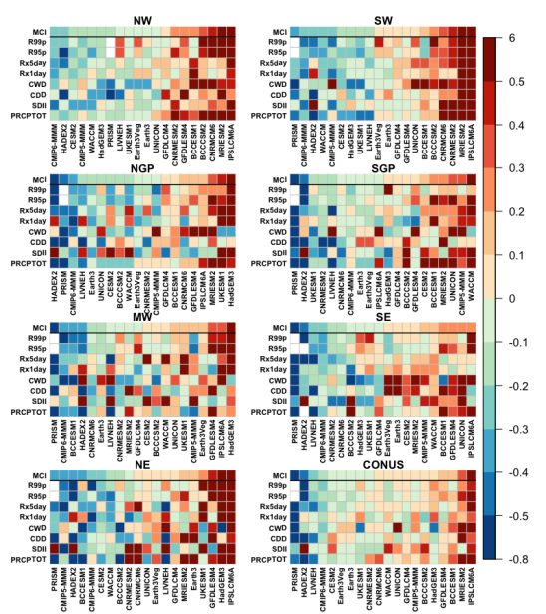
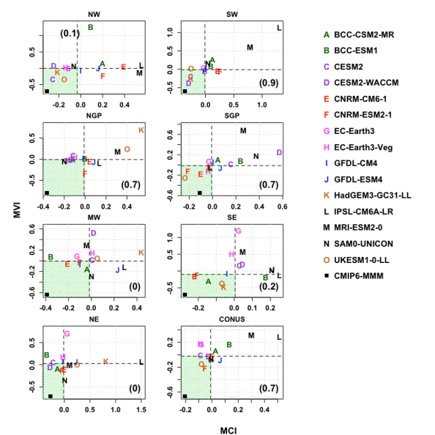


Evaluation of historical CMIP6 model simulations of extreme precipitation over contiguous US regions
Left: NRMSE. Blue is best; red is worst. Right: Scatter diagram of scores relative to CMIP6 multimodel median: NRMSE (X-axis) versus NIVSS (Y-axis). Models in green zones do better than CMIP6 median performance.
CMIP6 models historical simulations of: Expert Team on Climate Change Detection precipitation Indices are tested. Properties over space and time in seven National Climate Assessment regions and the Continental US (CONUS) are examined.
A CMIP6 multimodel median performs better overall than any individual model tested.
Multimodel medians are similar in CMIP5, but biases are smaller in CMIP6 models tested. Observational uncertainty is comparable to interquartile model spread.
Models and observations that do well in one region are not necessarily better elsewhere.
Models’ performance in simulating the observed (CPC data) mean and interannual variability of precipitation indices are estimated using the normalized root-mean-squared error (NRMSE) and interannual variability skill score (IVSS). Better models optimize NRMSE and IVSS.
Selected indices are PRCPTOT, SDII, CWD, CDD, Rx1day, Rx5day, R95p and R99p.
Other observational data tested: PRISM, Livneh, HadEx2.
Srivastava, A., Grotjahn, R., & Ullrich, P. (2020). Evaluation of historical CMIP6 model simulations of extreme precipitation over contiguous US regions. Weather and Climate Extremes, 100268. https://doi.org/10.1016/j.wace.2020.100268

