Slide 1
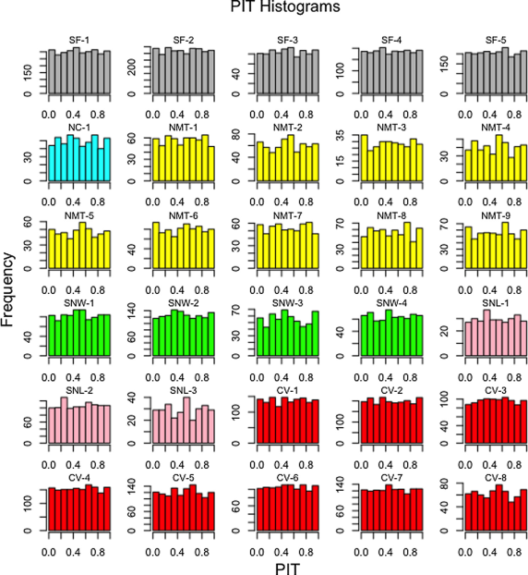
A unified approach to evaluating precipitation frequency estimates with uncertainty quantification: Application to Florida and California watersheds
A unified approach for IDF estimation involving regional frequency analysis, uncertainty quantification, and kriging is developed. Results are shown to be reasonably calibrated using the probability integral transform (PIT) histogram of the best fitted distribution.
IDF estimates (inches/day) over the Sacramento- San Joaquin watershed
The methodology is simpler than other methods and can be applied in other regions; it produces IDF estimates indistinguishable statistically from NOAA Atlas 14 reports. The estimates have less uncertainty than those in the NOAA Atlas 14. A novel aspect is the results are calibrated using PIT a histogram- a popular approach in probabilistic forecasting.
Hierarchical clustering is used for delineating homogeneous regions.
The regional frequency analysis uses L-moments.
Kriging is used for spatial mapping.
Use of z-scores accounts for estimation uncertainties when comparing PF estimates between datasets.
Srivastava, A., Grotjahn, R., Ullrich, P. A., & Risser, M. (2019). A unified approach to evaluating precipitation frequency estimates with uncertainty quantification: Application to Florida and California watersheds. Journal of Hydrology, 578, 124095. https://doi.org/10.1016/j.jhydrol.2019.124095

