Slide 1
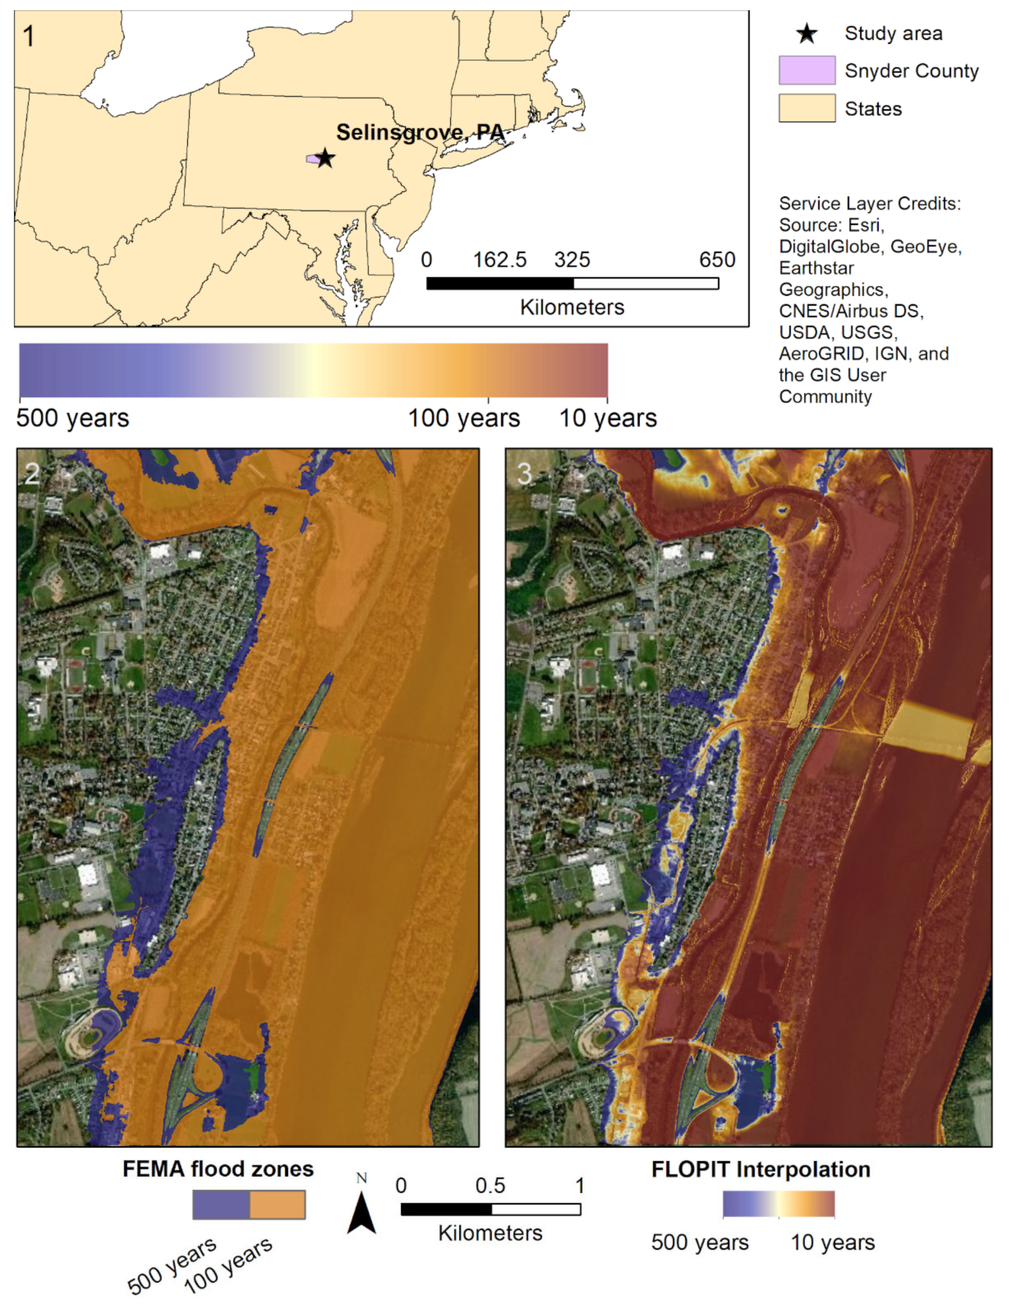
The FLOod Probability Interpolation Tool (FLOPIT): A Simple Tool to Improve Spatial Flood Probability Quantification and Communication
Objective
Here we develop, test, and demonstrate the FLOod Probability Interpolation Tool (FLOPIT) to produce continuous flood-probability maps.
Approach
FLOPIT uses water surface elevation inundation maps for at least two return periods and creates Annual Exceedance Probability as well as inundation maps for new return levels.
Impact
Flood probability interpolation tools, such as FLOPIT, can create spatially continuous flood probability maps. Continuous flood probability mapping has the potential to improve flood hazard communication, stakeholder decision-making, and the setting of actuarial flood insurance rates.
Figure: Map of a roughly 3 km reach of the Susquehanna River and tributaries at Selinsgrove, PA. Panel 1 shows the location of Snyder County and Selinsgrove, PA. Panel 2 shows the FEMA floodplains, derived from FEMA flood surface elevation data for the 1% and 0.2% annual chance (1 in 100-year and 1 in 500-year) floods. Panel 3 shows the FLOPIT interpolated flood probabilities, from 10% to 0.2% annual chance (1 in 10-year to 1 in 500-year).
Zarekarizi, M., Roop-Eckart, K. J., Sharma, S., & Keller, K. (2021). The FLOod Probability Interpolation Tool (FLOPIT): A Simple Tool to Improve Spatial Flood Probability Quantification and Communication. Water, 13(5), 666.

