Slide 1
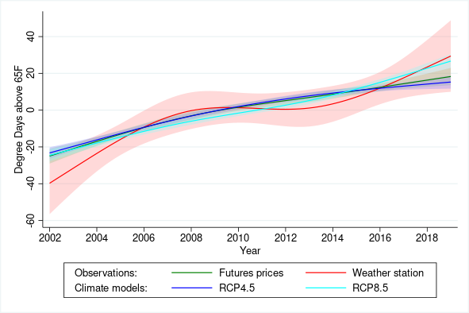
Market expectations of a warming climate
Objective
The Chicago Mercantile Exchange (CME) offers futures contracts for eight cities on two main weather products: cooling and heating degree days. The payoffs from these contracts depend on observed temperatures over the course of a month. We compare prices of financial derivatives whose payouts are based on future weather outcomes to CMIP5 climate model predictions as well as observed weather station data across eight cities in the US from 2001 through 2020.
Approach
We show that the long-term trends in derivative prices are comparable to station-level data and climate model output. The one exception is February in the northeastern US, where financial markets price in a polar vortex-induced cooling effect, a recent scientific finding that was not present in the older CMIP5 climate output. When looking at the spatial and temporal heterogeneity in trends, futures prices are more aligned with climate model output than observed weather station trends, suggesting that market participants closely align their expectations with scientific projections rather than recent observations.
Impact
Our paper is the first to use a direct measure of climate change expectations as derived from weather-based futures contracts. The evidence shows that financial markets incorporate warming trends that are consistent with climate model projections.
Figure: Nonlinear time trends for cooling degree day residuals, which are obtained by subtracting airport-by-month fixed effects among the eight airports and 4 summer months (June–September).
Schlenker, Wolfram, and Charles A. Taylor. 2021. “Market Expectations of a Warming Climate.” Journal of Financial Economics, April. https://doi.org/10.1016/j.jfineco.2020.08.019.

