Slide 1
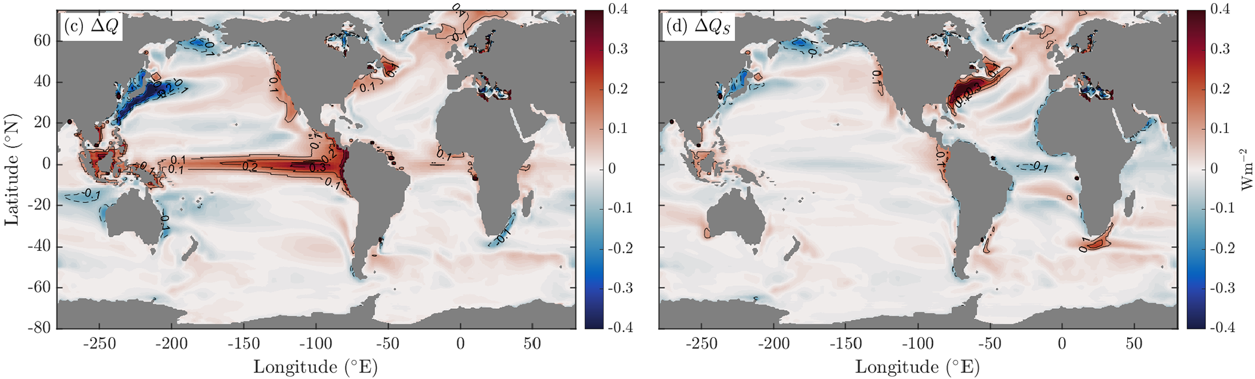

Interpreting modeled oceans across CMIP eras and the latest observations
Science
Ocean models have been in development for sixty years, while numerous refinements to the Equation of Seawater (EOS) have occurred
The EOS used underpins accurate calculation of key quantities (e.g. ocean heat content [OHC], surface heat fluxes, ocean-to-atmos heat transports, etc) ensuring model realism (see panels on right)
Impact
Framework outlined to most directly compare ocean fields across numerous CMIP eras, and EOS variants with a focus on model temperature and salinity variables
Recommends modelers clearly define fixed variables, equations and coefficients required for calculation/comparison of derived quantities
Recommends modelers migrate code to TEOS-10 which will resolve standing problems going forward, enabled direct obs-model comparisons
Above: additional heat received/lost by an ocean model compared to heat lost/received by the atmospheric model (ΔQ units: W m⁻²)
Below: contribution of near-surface salinity variations to the air-sea heat flux discrepancy (ΔQ_{S} units: W m⁻²)
Summary
Currently direct comparison to latest generation observations complicated when comparing ~EOS-80 models to TEOS-10 observed fields
The global ocean is responsible for the bulk of 1971-2018 Earth System excess heat storage (396 ZJ, 91%) due to anthropogenic influence
How future OHC and uptake is modulated will strongly impact realized near-surface warming
Reference:
McDougall, T. J., P. M. Barker, R. M. Holmes, R. Pawlowicz, S. M. Griffies and P. J. Durack (2021) The interpretation of temperature and salinity variables in numerical ocean model output and the calculation of heat fluxes and heat content. Geoscientific Model Development, 14 (10), pp 6445-6466. DOI: 10.5194/gmd-14-6445-2021

Slide 2
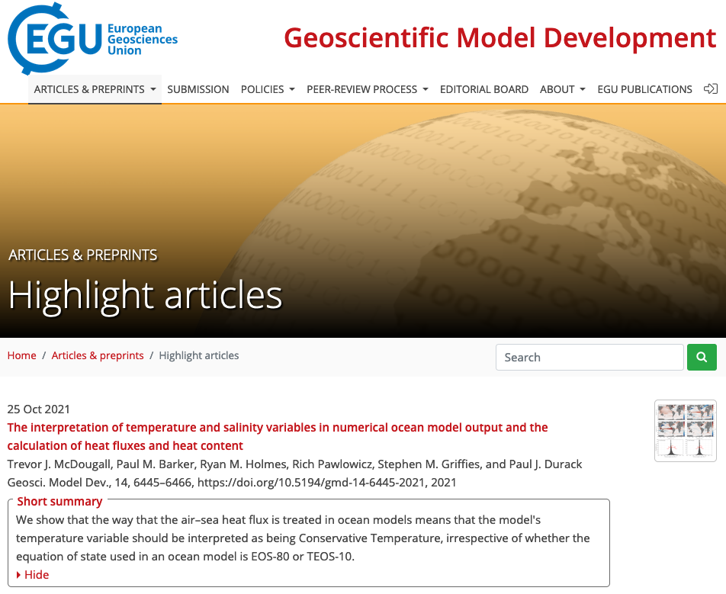
Interpreting modeled oceans across CMIP eras and the latest observations
Reference:
McDougall, T. J., P. M. Barker, R. M. Holmes, R. Pawlowicz, S. M. Griffies and P. J. Durack (2021) The interpretation of temperature and salinity variables in numerical ocean model output and the calculation of heat fluxes and heat content. Geoscientific Model Development, 14 (10), pp 6445-6466. DOI: 10.5194/gmd-14-6445-2021

