Slide 1
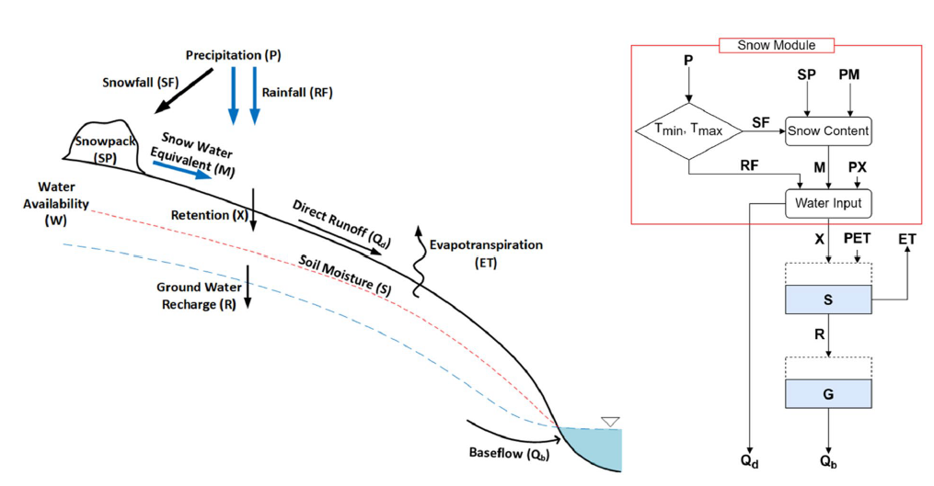
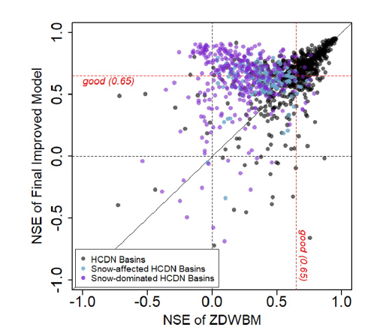
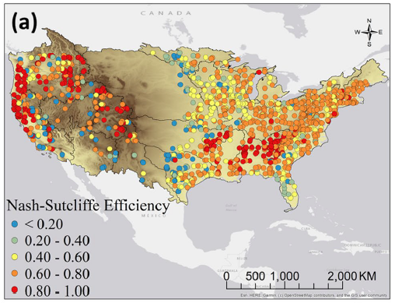
An Improved Zhang's Dynamic Water Balance Model Using Budyko-Based Snow Representation for Better Streamflow Predictions
Objective: To improve Zhang's monthly water balance model (a physics-based conceptual hydrologic model) that reflects the physical partitioning process of the hydrological cycle at the basin level based on regional climate and catchment characteristics.
Approach: We introduce a snow module based on surface energy balance and Budyko-limits on melting and combine it with the existing water balance equations. Moreover, monthly parameterization is applied to the model to better explain the time-varying hydrological characteristics of a catchment. The proposed model involves five different monthly parameters, which determine the physical partitioning process of the hydrological cycle, and they are regionally calibrated and validated under Budyko-type constraints. The model is applied to 1,210 basins across the continental United States (CONUS), and the simulated streamflow is compared to the observed data.
Results/Impacts: The proposed model significantly outperformed the original model, improving the median NSE by 31% (from 0.51 to 0.67) and increasing the number of catchments with an acceptable NSE by 58%. The spatial variability of the basin characteristics across the CONUS is also investigated based on the calibrated parameters. Our analyses suggest that ZDWBM-msnow could be used to estimate monthly runoff for ungauged basins across the continental United States.
Hwang, J., & Devineni, N. (2022). An improved Zhang’s dynamic water balance model using Budyko-based snow representation for better streamflow predictions. Water Resources Research, 58, e2021WR030203. https://doi.org/10.1029/2021WR030203

