Slide 1
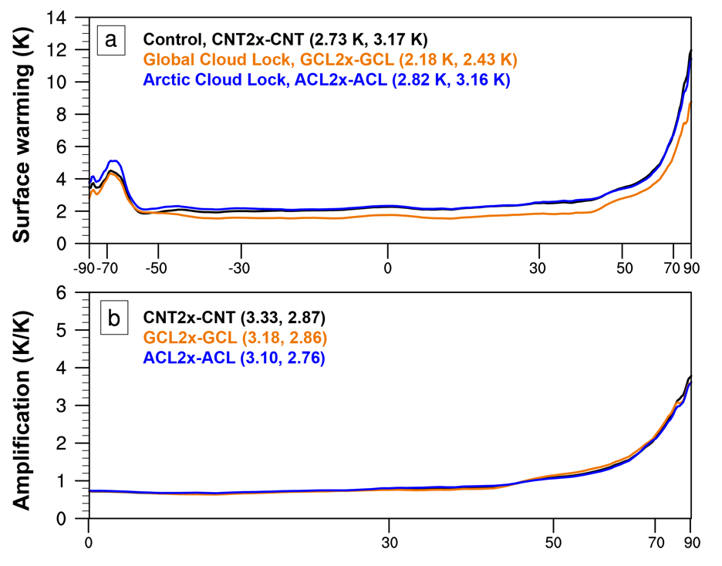
Quantifying the Influence of Cloud Radiative Feedbacks on Arctic Surface Warming Using Cloud Locking in an Earth System Model
E.A. Middlemas, J.E. Kay, B. Medeiros, and E.A. Maroon Geophysical Research Letters, https://doi.org/10.1029/2020GL089207
Objective
Evaluate the roles of local vs global cloud feedbacks on the amplified warming in the Arctic.
Approach
Using coupled CESM1 simulations with pre-industrial and 2xCO2 forcing, evaluate feedbacks.
Apply cloud-locking to disable cloud feedbacks either globally or only in the Arctic.
Compare with more conventional radiative kernel diagnostics of feedbacks.
Impact
This study is the first to specifically target the impact of local feedbacks in the Arctic using a specialized methodology called cloud-locking applied in a specific region.
The results show that both local and global cloud feedbacks have little impact on the amplified warming of the Arctic; lower-latitude cloud feedbacks are shown to contribute to the global warming, but not the amplification.
Globally, cloud feedbacks in CESM1 are strongly positive, and compare well with diagnostic methods
Non-cloud feedbacks are also shown to sum to a nearly invariant total with or without cloud-locking, but water vapor and lapse rate feedbacks are individually strongly changed when clouds are locked
Zonal mean response to a carbon dioxide doubling for control (CNT), global cloud locking (GCL) and Arctic cloud locking (ACL): a) surface warming, b) amplification with respect to the northern hemisphere mean warming.

