Slide 1
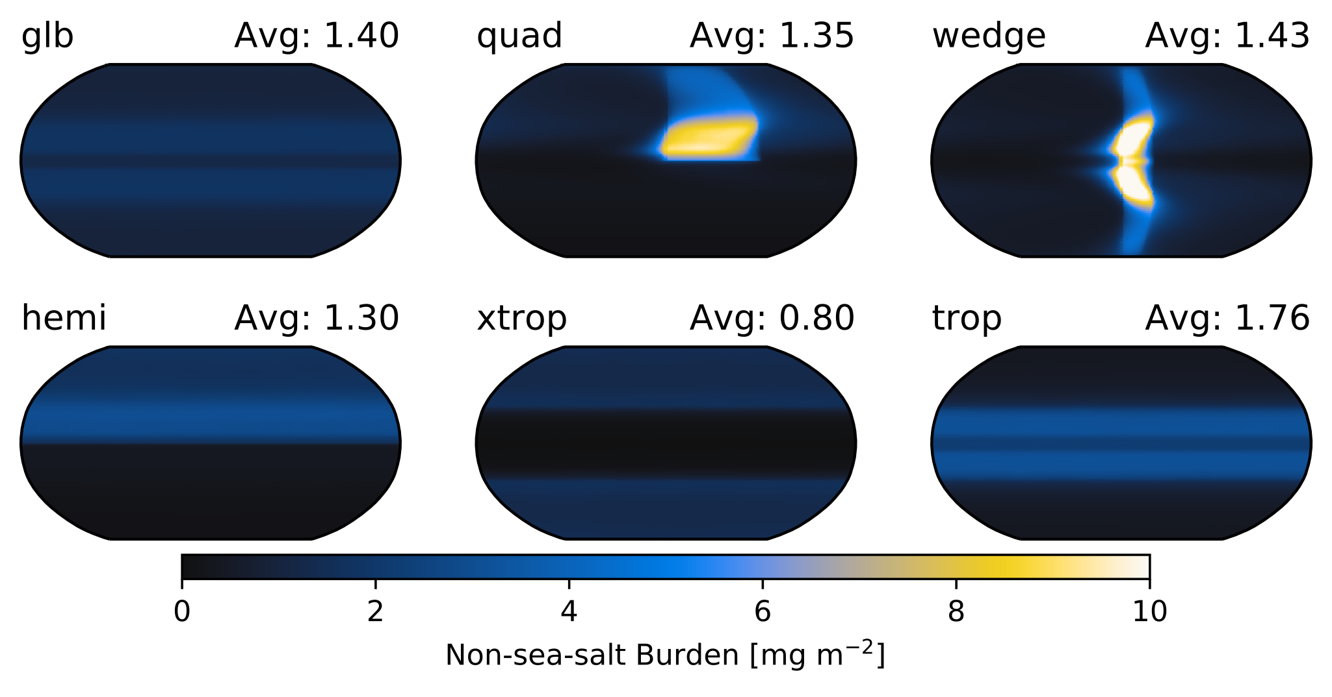
Aquaplanets as a framework for examination of aerosol effects
Brian Medeiros Journal of Advances in Modeling Earth Systems, https://doi.org/10.1029/2019MS001874
Objective
Propose idealized aquaplanet configurations as a testbed for investigating aerosol effects on climate.
Approach
Adapt existing CESM2-CAM6 aquaplanet configuration to use the same nucleation as standard CAM6.
Redistribute pre-industrial emissions in idealized geographic patterns.
Analyze effective radiative forcing.
Investigate aerosol-cloud interactions.
Impact
Aquaplanets are able to capture many of the features of aerosol forcing and aerosol-cloud interactions as realistic models.
Statistics are robust for short simulations, making aquaplanets an efficient framework for exploration and development.
CAM6 tropical clouds appear to be very sensitive to changes in aerosol, signaling a regime-dependence of aerosol effects.
Illustration of the different geographical patterns of emissions in aquaplanet experiments. Total burden of non-sea-salt aerosol; global average is given in the upper right of each panel. All these simulations use the same global mean emissions, so the differences are due to the complex interactions between aerosols, clouds, and circulation.

