Slide 1
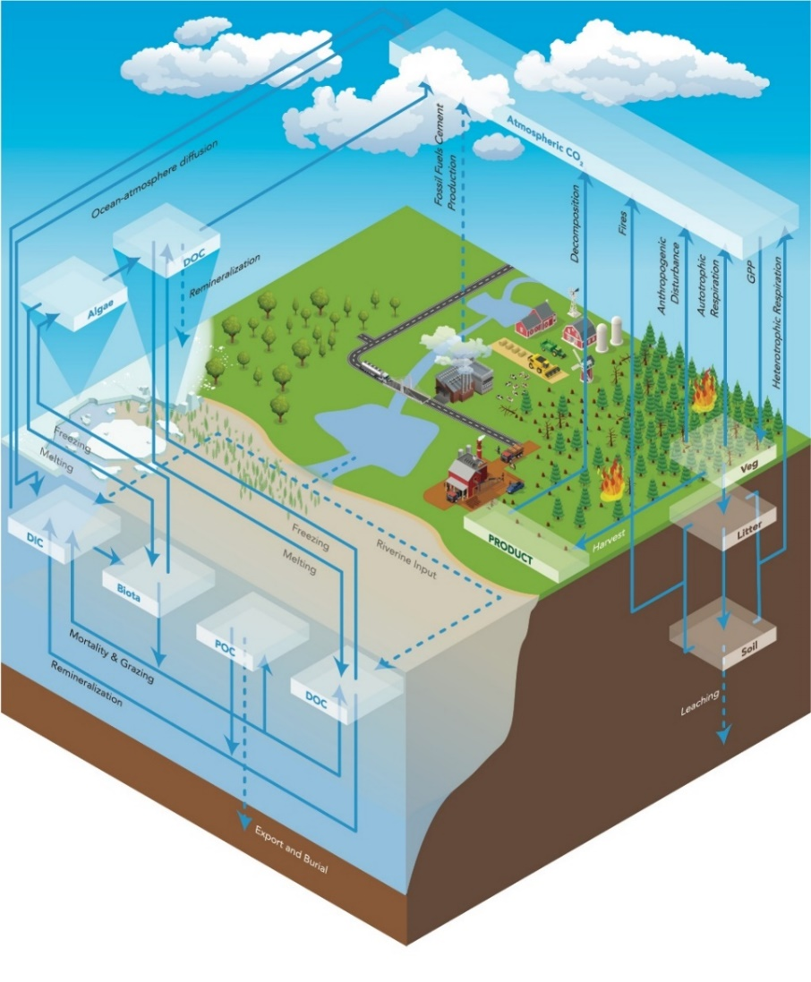
Carbon and Nutrient Cycles in the Energy Exascale Earth System Model
Objective
Introduce, describe, and evaluate improved carbon and nutrient cycle modeling capabilities in the U.S. Department of Energy's Energy Exascale Earth System Model (E3SM) creating E3SMv1.1-BGC.
Approach
Characterize ecosystem-climate responses in a standard set of simulations.
Evaluate the model using observational benchmarks, such as measurements of atmospheric carbon dioxide concentrations and surface exchange.
Explore the impact and structural uncertainties of terrestrial nitrogen and phosphorus limitations.
Impact
The evaluation showed significant improvements to the land-based carbon cycle compared to previous models. Important biases were identified in the ocean carbon cycle, which will be improved in future versions of E3SM.
E3SMv1.1-BGC provides a platform for future studies of coupled Earth systems. It represents an important step towards the development of an emission-driven model in E3SMv2, which will enable studies of the Earth system response to a range of future energy scenarios.
E3SMv1.1-BGC allows researchers to model the Earth’s carbon cycle and how it interacts with land use and energy systems.
Burrows, et al., “The DOE E3SM v1.1 biogeochemistry configuration: description and simulated ecosystem-climate responses to historical changes in forcing,” Journal of Advances in Modelling Earth Systems, 12, e2019MS001766. (2020) https://doi.org/10.1029/2019MS001766 .
Notes:
http://www.pnnl.gov/science/highlights/highlights.asp?division=749

