Slide 1
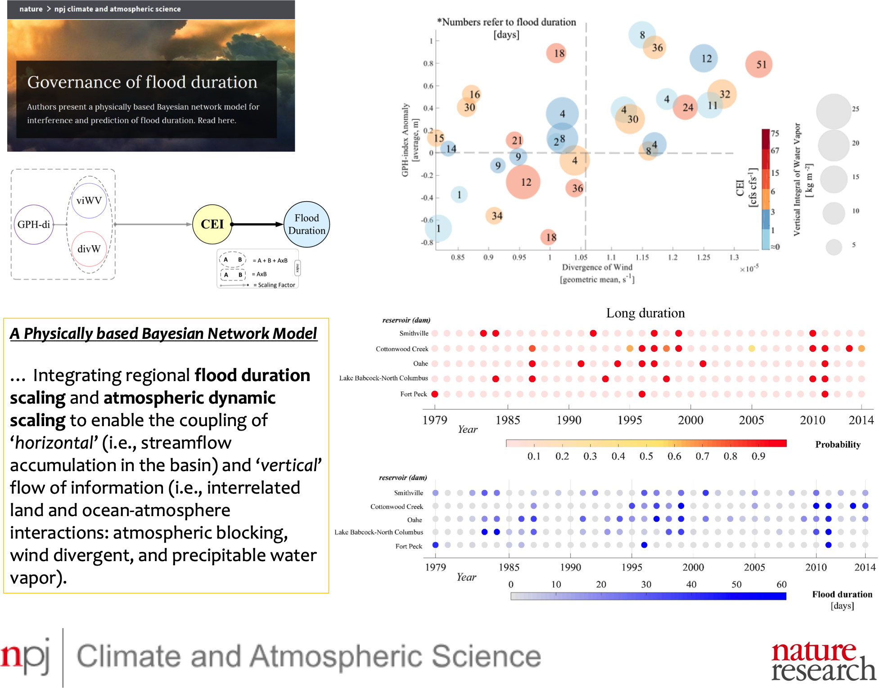


Governance of Long-Duration Floods
Objective: To explain how flood duration scales with antecedent flow and atmospheric patterns, which are the primary contributing factors originating from the coupled land‐ocean‐atmosphere dynamic system.
Approach: Using a physically based Bayesian network model for inference and prediction of flood duration that allows for a deeper understanding of the nexus of antecedent flow regime, atmospheric blocking, and moisture transport/release mechanisms.
Results/Impacts: The synergy between a large persistent low-pressure blocking system and a higher rate of divergent wind often triggers a long-duration flood, even in the presence of moderate moisture supply in the atmosphere. This condition, in turn, causes an extremely long-duration flood if the basin-wide cumulative flow prior to the flood event was already high.
This predictive model can aid in decision support systems for the protection of national infrastructure against long-duration flood events.
Najibi, N., Devineni, N., Lu, M., & Perdigão, R. A. Coupled flow accumulation and atmospheric blocking govern flood duration, npj Climate and Atmospheric Science, 2(1), 19, 2019. https://doi.org/10.1038/s41612-019-0076-6

