Slide 1
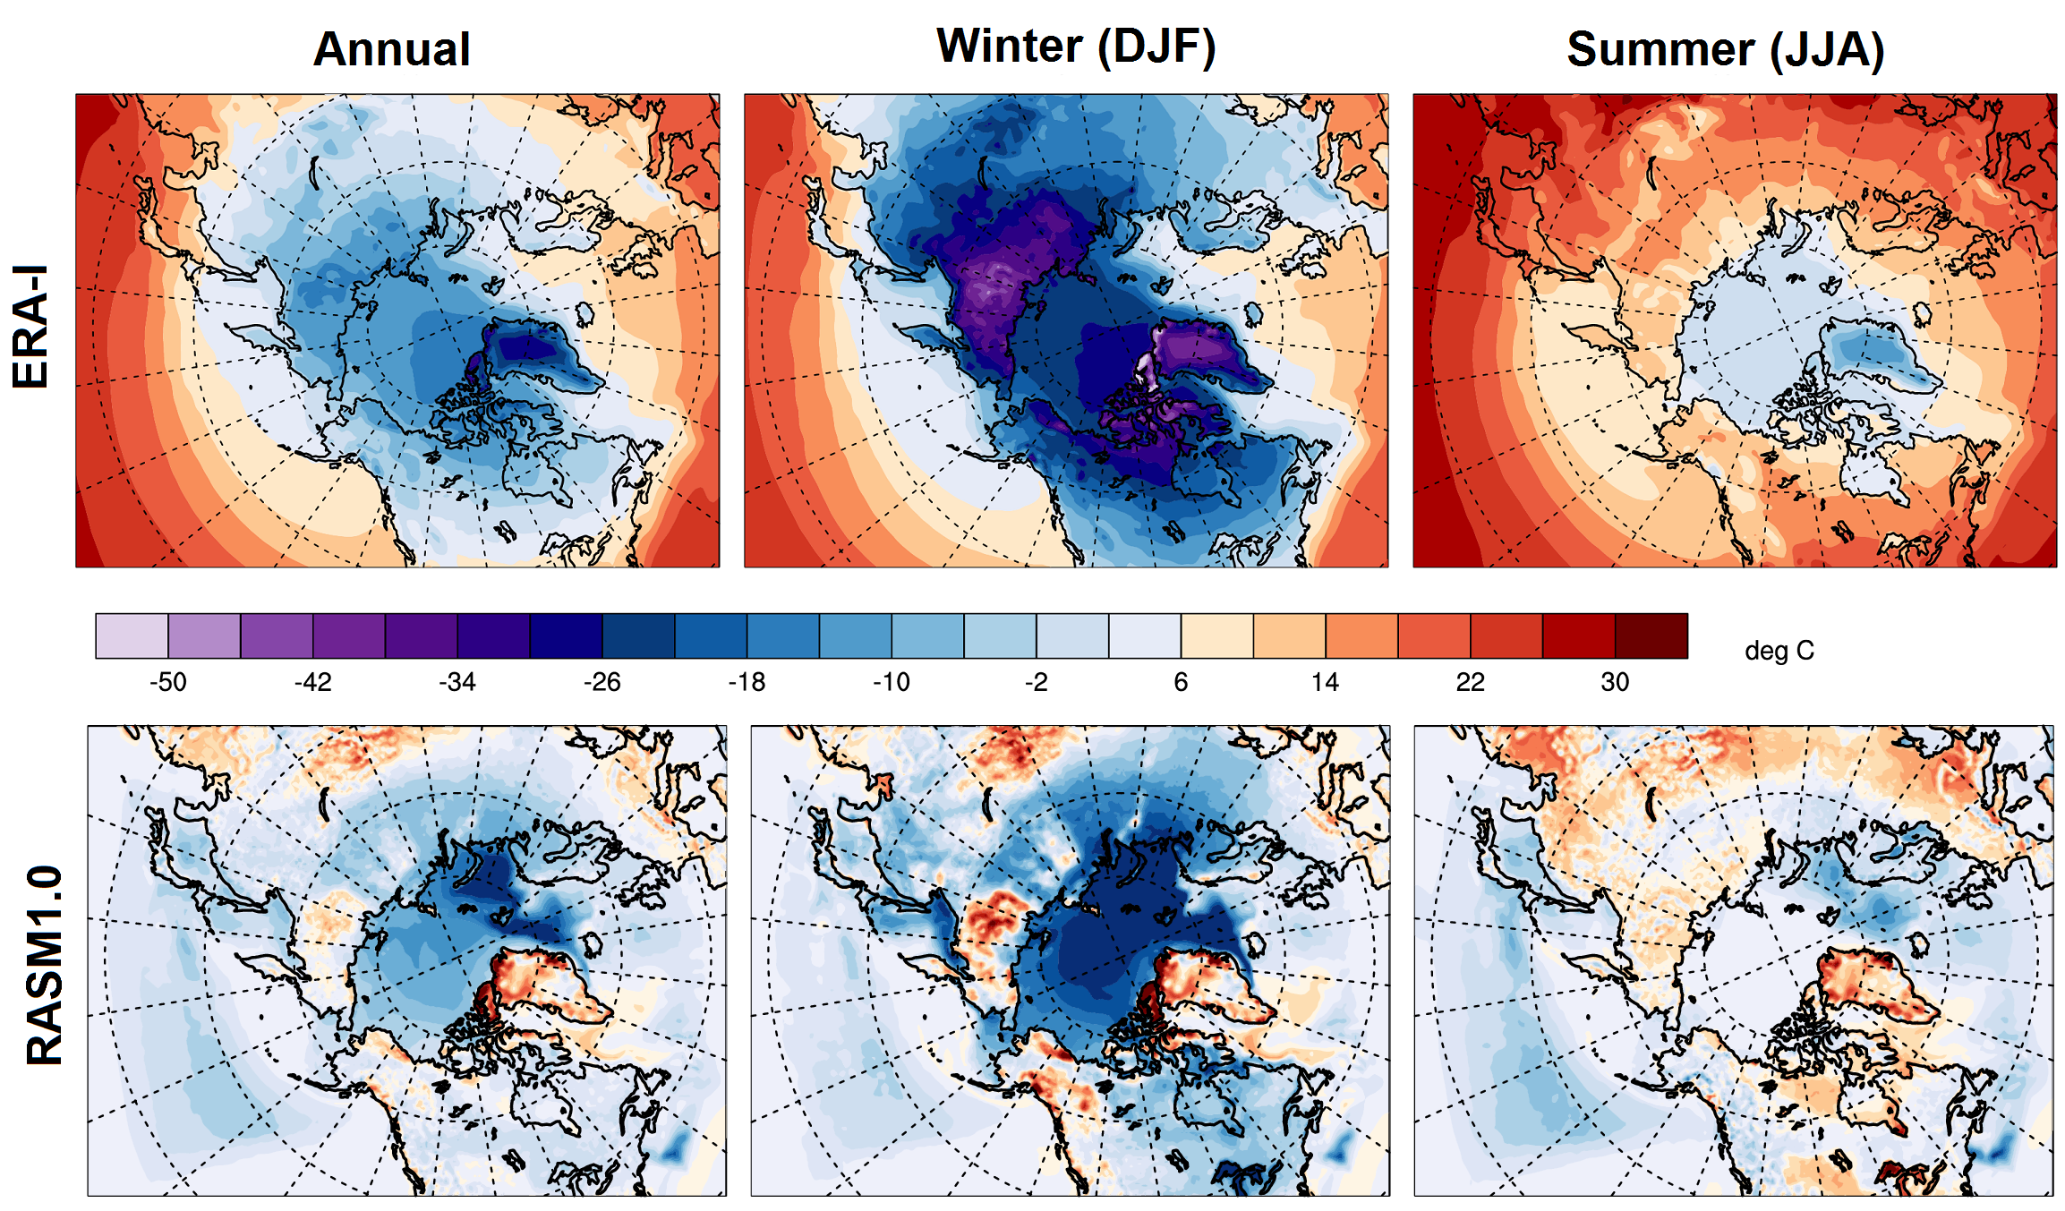
Development of the Regional Arctic System Model (RASM): Near-Surface Atmospheric Climate Sensitivity
Objective
Develop the next generation of regional Arctic system model and evaluate its near surface climate and sensitivity to changes in model physics
Approach
Develop the Regional Arctic System Model (RASM) from the WRF atmospheric model, VIC land hydrology model, POP ocean model, and CICE sea ice model
Evaluate RASM near-surface climate using ERA-Interim reanalysis data and satellite observations of sea ice and radiative fluxes
Attempt to minimize cloud and radiation biases in RASM with changes to the atmospheric model boundary layer and convective physics
ERA-I (top) surface temperature and RASM1.0 (middle) and RASM_atm_ice (bottom) surface temperature biases.
Impact
Atmospheric circulation is well simulated
Cloud and associated radiative errors result in significant surface temperature biases
Surface temperature biases impact domain-wide evaporation and precipitaiton
Changes in WRF convective and boundary layer parameterizations reduce cloud, radiation, temperature, and precipitation errors over oceanic portions of model domain
Cassano, J J, DuVivier, A, Roberts, A, Hughes, M, Seefeldt, M, Brunke, M, Craig, A, Fisel, B, Gutowski, W, Hamman, J., Higgins, M, Maslowski, W, Nijssen, B, Osinski, R, and Zeng, X (2017) Development of the Regional Arctic System Model (RASM): Near-Surface Atmospheric Climate Sensitivity. J. Clim., doi:10.1175/JCLI-D-15-0775.1.

