Slide 1
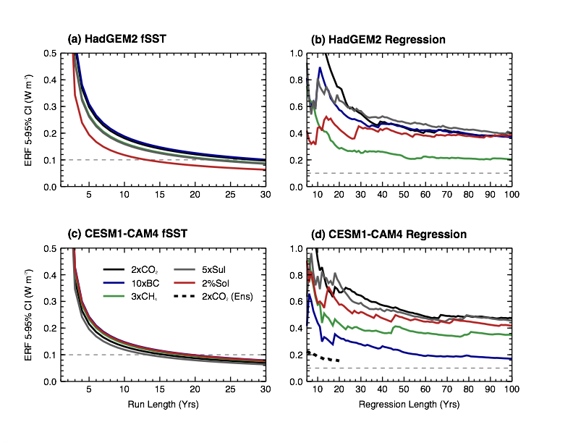
Radiative Forcing MIP
RFMIP seeks to characterize effective radiative forcing for CMIP and understand how differences in this forcing arise between models
Atmosphere-only simulations to characterize effective radiative forcing.
Complementary efforts to understand parameterization errors in instantaneous radiative forcing for greenhouse gases and aerosols
Coupled simulations using CMIP6 specification of aerosol optical properties for hypothesis testing, detection and attribution
Recent publications establish the protocol and demonstrate its accuracy Pincus et al., 2016, doi:10.5194/gmd-9-3447-2016 Forster et al., 2016: doi:10.1002/2016JD025320

