Slide 1
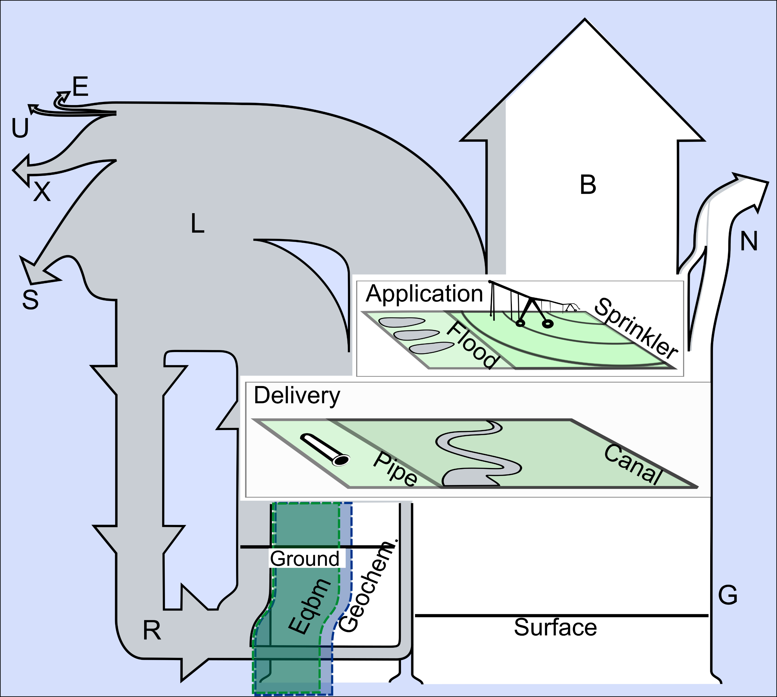
Interplay of changing irrigation technologies and water reuse: example from the upper Snake River basin, Idaho, USA
Objective
Our manuscript quantified the effects on downstream flow and aquifer storage from increasing irrigation efficiency coupled with enhanced aquifer recharge. Each adaptation can reduce water available to different irrigators, but when applied together, we should maximum delivery to all groups. Determined the role irrigation water reuse plays as irrigation efficiency and enhanced aquifer recharge are increased from a baseline.
Evaporation
Use
Export
Beneficial Use
Non-consumptive
Loss
Storage
Non-beneficial
Consumption
Approach
We performed a suite of simulations using the University of New Hampshire Water Balance Model (WBM) that used progressively more efficient irrigation technologies, which are represented explicitly in the model. Each simulation was run with and without sufficient enhanced aquifer recharge to maintain aquifer head at today’s level.
Gross Irrigation
Impact
Coupling the two adaptations mitigated adverse effects from each individually; however, aquifer head was always affected more than downstream flow. Where surface and groundwater is managed as a single resource (conjunctively), groundwater irrigators will likely experience more significant shortfalls as both measures are implemented.
Reuse
Figure: Diagram of fates of water abstracted for irrigation across the USRB. Flow-line widths are scaled proportionally to fluxes across the simulation domain between 2008 and 2017 at the baseline parameterization. White depicts abstractions from pristine sources, whereas water lost nonconsumptively from irrigation delivery or application during the model epoch is gray. Equilibrium (Eqbm) and geochemical (Geochem.) fractions of groundwater abstractions relax assumptions about aquifer water composition.
Zuidema, S., Grogan, D., Prusevich, A., Lammers, R., Gilmore, S., and Williams, P.: Interplay of changing irrigation technologies and water reuse: example from the upper Snake River basin, Idaho, USA, Hydrol. Earth Syst. Sci., 24, 5231–5249, https://doi.org/10.5194/hess-24-5231-2020, 2020.

