Slide 1
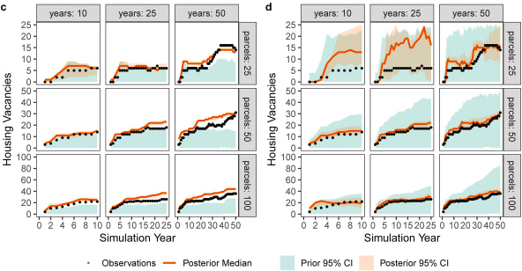
Small increases in agent-based model complexity can result in large increases in required calibration data
Objective
Agent-based models (ABMs) are often used to analyze human behavior in coupled natural-human systems. However, ABMs are often not statistically calibrated. We examine the amount and structure of data required to statistically calibrate ABMs of differing complexities.
Approach
We use a perfect model experiment to examine parameter estimation and model structure selection. We use a known ABM of housing abandonment under flood risk to generate pseudo-datasets of varying spatial and temporal sizes and use these pseudo-data to calibrate the data-generating model and another, more complex, ABM.
Impact
We show how limited data sets may not adequately constrain a simple ABM with relatively few parameters and minimal within-model interactions. We also illustrate how limited data can be insufficient to identify a known data-generating model structure.
Figure: Prior and posterior hindcasts of the number of vacant parcels – Panel c) for a simpler model, and panel d) for a more complex model with additional interactions between agents. Each panel includes the hindcasts for varying combinations of observed years and parcels. Modified from Srikrishnan & Keller (2001) under a CC-BY-4.0 license.
Srikrishnan V, Keller K. 2021. Small increases in agent-based model complexity can result in large increases in required calibration data. Environmental Modelling & Software. 138:104978

