Slide 1
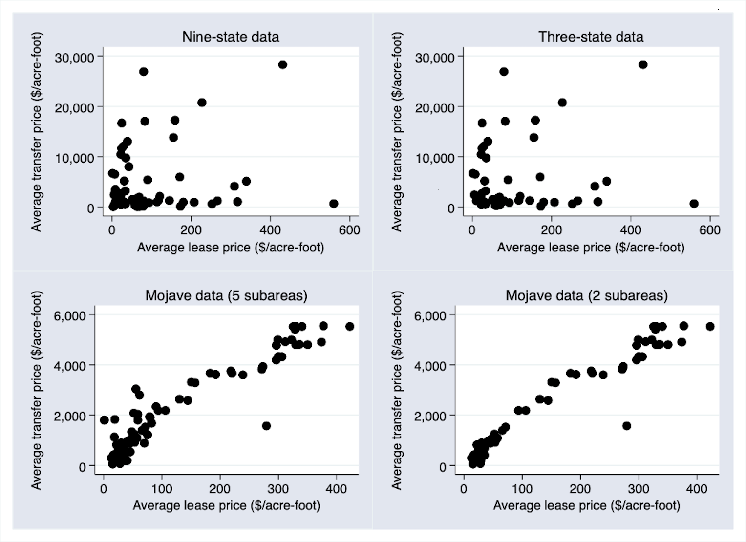
How well do U.S. western water markets convey economic information?
Objective
The ability to quantify the efficiency of water rights transfers as a whole provides an opportunity to measure progress in market development, learn from better-functioning markets, and as a result, advance policies to reduce barriers to water trading. Therefore, an important
area of study—which has been largely missing in the
water market literature—is the role of pricing mechanisms
in water rights markets.
Approach
The purpose of this study is to assess the efficiency of western U.S. water rights markets by utilizing the asset pricing model to measure how well prices reflect long-run returns to permanent water rights. We exploit the variation in prices and quantities for water trades in the western United States between 1990 and 2010 to assess water markets’ capacity to incorporate available information about long-run returns.er.
Impact
We find that water market efficiency is highest in water markets that are known to have lower barriers to trade. Locational differences in results suggests that there is significant potential for efficiency improvements in water rights markets in the western U.S., which could lead to higher welfare gains from the reallocation of water.
Figure: Average (quarterly) lease and transfer prices in the multi-state data and the Mojave data
Rimsaite, R., K. Fisher-Vanden, S. Olmstead, 2021, “How well do U.S. western water markets convey economic information?” Land Economics, Feb 2021

