Slide 1
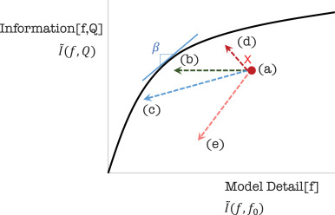
On choosing the resolution of normative models
Objective
Although the choices of the level of spatial and temporal aggregation in sectoral and multi-sectoral dynamics (MSD) models are viewed as critically important determinants of model credibility and impact, these choices are typically made on an ad hoc basis with limited and incomplete testing. This study develops an approach to improving this situation.
Approach
The study proposes a more systematic approach to making these choices for normative models based on fundamental optimization and information theory concepts. Simple examples of the application of this methodology and possible extensions of it to non-normative models are included.
Insert graphic or table or bullets showcasing results here
Figure: Assessing if a reduction in detail moves a model relatively closer to the appropriateness frontier. (a) → (b) is an easy-to-verify improvement by asking does compression change information returned by the model. If the returned information changes, it is necessary to judge if the path is the improving (a) → (c) or the unwanted (a) → (e). The path(a) → (d), meanwhile, is impossible by the definition of compression in the setup of our problem.
Impact
The study develops principles for trading off accuracy of representation versus parsimony and a ‘modeling roadmap’ to help the MSD modeling community apply these ideas. This approach and possible extensions to it should help the modeling community improve the credibility and impact of MSD modeling systems.
James H. Merrick, John P. Weyant, On choosing the resolution of normative models, European Journal of Operational Research, 279(2) (2019), doi:https://doi.org/10.1016/j.ejor.2019.06.017

