Slide 1
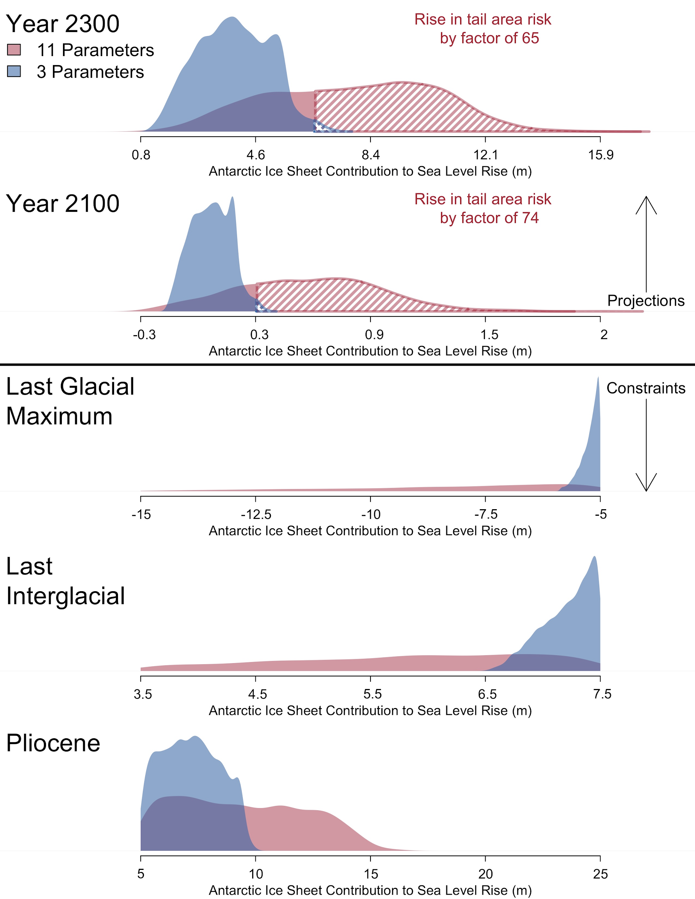
A Fast Particle-Based Approach for Calibrating a 3-D Model of the Antarctic Ice Sheet
Objective
Improve the quantification of uncertainties surrounding sea-level projections.
Approach
Calibrate the state-of-the-art Pennsylvania State University 3D Antarctic Ice Sheet model (PSU3D-ICE).
Develop a new particle-based approach to calibrate computer models with moderate model run times and many model parameters.
Bayesian model calibration using a massively parallelized adaptive sequential Monte Carlo approach on high performance computing systems (2000+ cores).
Examine probabilistic projections of sea level rise under deep parametric uncertainty.
Impact
In 2300, tail area risk increases by a factor of 65 when accounting for more unknown model inputs.
New methodology enables computer experiments that were previously infeasible:
More knowledge of the Antarctic ice sheet in the Pliocene era sharpens sea level projections
Prior knowledge of unknown model parameters directly impacts sea level projections.
Figure: Antarctic ice sheet contribution to sea level change in the Pliocene era, Last Interglacial Age, Last Glacial Maximum, 2100, and 2300. Red shading represents the posterior samples for each time period and projections using our fast particle-based approach (11 parameters). Blue shading represents the posterior sample from the emulation-calibration method (3 parameters). The striped shading denotes the 99% quantile for the two methods.
(figure redrawn from original data in Lee et al., 2020)
Lee, B. S., Haran, M., Fuller, R. W., Pollard, D., & Keller, K. (2020). A fast particle-based approach for calibrating a 3-D model of the Antarctic ice sheet. Annals of Applied Statistics, 14(2), 605-634. doi:10.1214/19-AOAS1305

