Slide 1
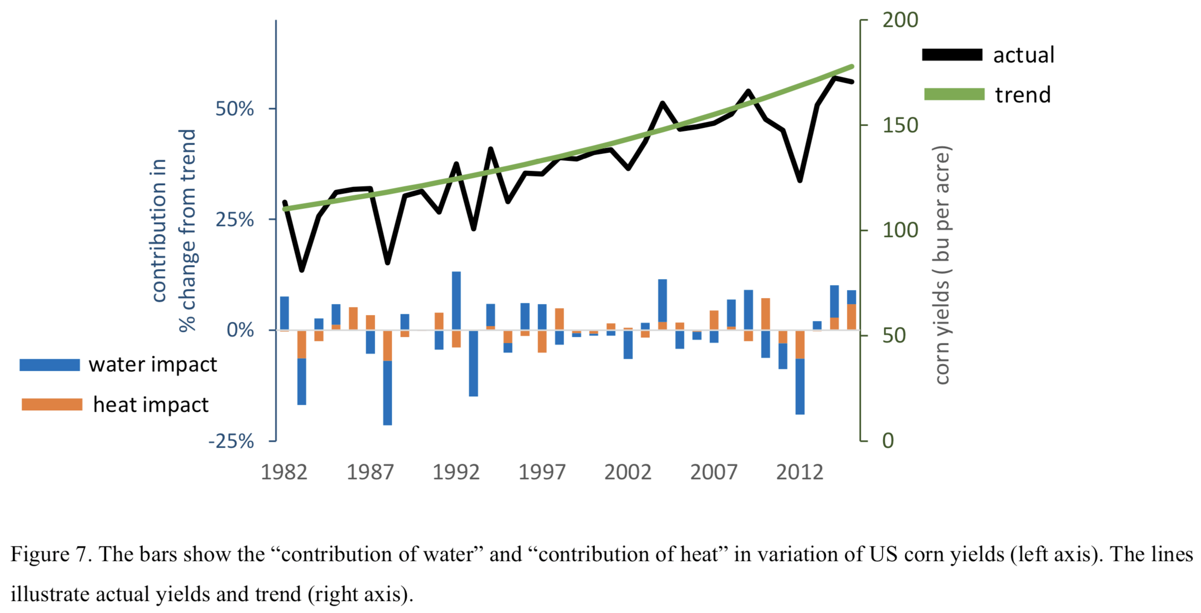
Quantifying the Impacts of Compound Extremes on Agriculture
Modeled corn yield response to extreme heat is more accurate when considering daily interactions with soil moisture instead of heat alone.
Average yield damage from heat stress has been up to four times more severe when combined with water stress
Objective
Estimations from statistical crop models using averaged water availability metrics can be biased due to significant changes in the frequency and intensity of future extreme precipitation and temperature. The aim of this study is to improve the statistical estimation of corn yield response to extremes.
Approach
This study combines a fine-scale weather product with outputs of a hydrological model to construct functional metrics of individual and compound hydroclimatic extremes for agriculture. Then, a yield response function is estimated with individual and compound metrics focusing on corn in the United States during the 1981-2015 period.
Impact
This paper serves to bridge the gap between statistical studies of the impacts of hydroclimatic extremes on crops and their biophysical counterparts by recognizing the central role of soil moisture in understanding crop yields. Also, the insights gained from incrementally adding higher temporal-resolution metrics of water extremes to the models are valuable for understanding the drivers of corn yield variability, and for revealing the resolution of water availability data required to capture future extremes.
Haqiqi, I., Grogan, D. S., Hertel, T. W., and Schlenker, W.: Quantifying the impacts of compound extremes on agriculture, Hydrol. Earth Syst. Sci., 25, 551–564, https://doi.org/10.5194/hess-25-551-2021, 2021.

