Slide 1
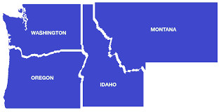
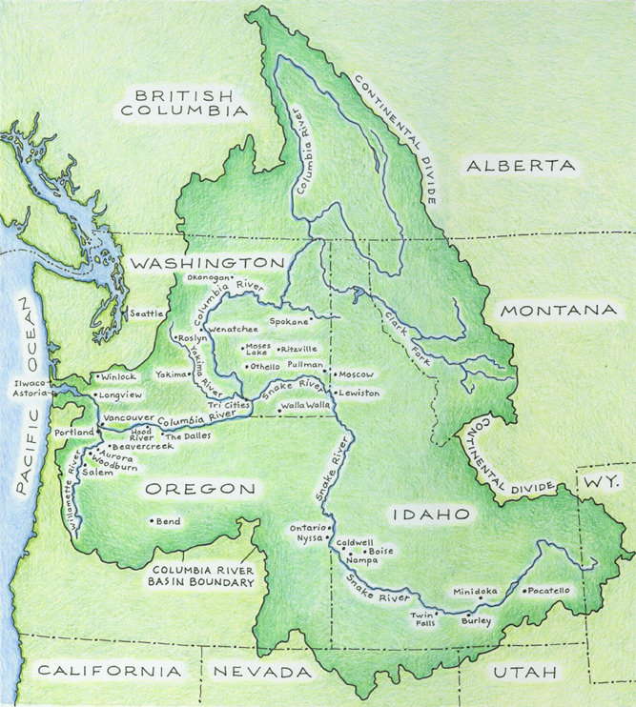
Come Hell or High-Water:
Challenges for Adapting Pacific Northwest Water Law
Objective
This paper examined the challenges facing the four Pacific Northwestern states– Oregon, Washington, Idaho, and Montana– in adapting their water allocation systems in the face of climate change, tribal water rights, instream flow needs and the Endangered Species Act, transboundary issues, and other drivers of change.
Approach
As a review, this paper analyzed the federal drivers of change and then focused on each state. We reviewed the background of each state’s water law, then addressed the following:
Instream flow rights/water markets/fisheries
Tribal water rights
Challenges and opportunities for managing water resources, including groundwater
Impact
We find that each state is struggling to update its laws and regulations to adapt to a quickly changing set of dynamics, both natural and human. By comparing each state, this paper highlights opportunities for learning what works and could be tried elsewhere.
Upper figure: four states examined in this paper
Lower figure: Columbia River Drainage Basin.
Map from WSU, Columbia River Basin Ethnic History Archives Home Page, https://content.libraries.wsu.edu/customizations/collection/cchm/pages/img/crbasin_map.jpg
Robert T. Caccese and Lara B. Fowler, Come Hell or High-Water: Challenges for Adapting Pacific Northwest Water Law, 37 Pace Envtl. L. Rev. 319 (2020) Available at: https://digitalcommons.pace.edu/pelr/vol37/iss2/2

