Slide 1
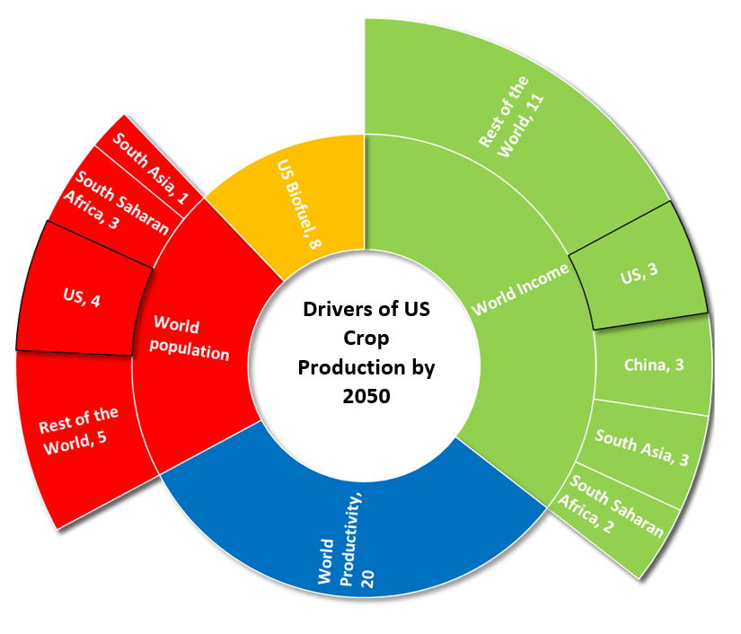
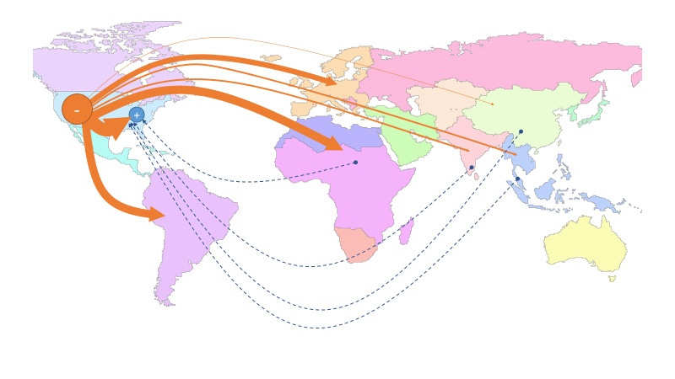
SIMPLE-G: A multiscale framework for integration of economic and biophysical determinants of sustainability
Objective
This paper introduces SIMPLE-G, a Simplified International Model of agricultural Prices, Land use, and the Environment- Gridded version, which is a multiscale framework for analyzing the land-water-energy nexus in a global context while accounting for local heterogeneity in land and water resources.
(a)
Approach
A global economic model integrating regional economic systems with food demand and international trade and gridded biophysical systems connected to land use (e.g. land, water, energy, fertilizer, climate, crop yields, wetlands, etc.)
Impact
SIMPLE-G is the first attempt to undertake global economic analysis of sustainability challenges at the interface of agriculture and the environment using a grid-resolving approach. The outcomes of the model provide quantitative insights about global-to-local connections (e.g. FIG-a: the growth in income and population outside the US is far more important in driving US crop production than growth within the US) and local-to-global linkages (e.g. FIG-b: while the aggregate impact of the water withdrawal restriction on US crop production and land use is modest, it has a significant impact on the pattern of crop production and cropland area).
(b)
Figure: a) Drivers of US Crop Production: 2010-2050; b) relocation of global crop production due to groundwater sustainability policy in the Western US
Baldos, U. L. C., Haqiqi, I., Hertel, T. W., Horridge, M., & Liu, J. (2020). SIMPLE-G: A multiscale framework for integration of economic and biophysical determinants of sustainability. Environmental Modelling & Software, 133, 104805. doi:10.1016/j.envsoft.2020.104805

