Slide 1
Introduction to the Special Issue on Ocean Warming
Objective
Considerable progress in understanding marine climate and ecosystem variability and change has been achieved in the last decade
This progress is scattered across the broad marine science literature
Collating key contributions into a special issue to highlight science progress was the primary objective
Methodology
Draw together specialists covering long-term global ocean variability and change, to regional and extreme events along with ecosystem specialists
Many aspects of climate and ecosystem variability and change are now better understood due to progress in observing and modeling the global ocean
Impact
The special issue collected 15 individual contributions highlighting topics such as long-term warming of the ocean from the surface to the deep, unforced ocean variability, the ocean view of the surface warming hiatus, simulations of extreme waves from hurricanes, ocean-cryosphere interactions, and case studies of recent change to the coral reefs of Palau to Arctic benthic macrofauna
Reference: P. J. Durack, A. Sen Gupta and L. H. Smedsrud (2018) From the Guest Editors: Introduction to the Special Issue on Ocean Warming. Oceanography, 31 (2), 28-31. doi: 10.5670/oceanog.2018.226

Slide 2
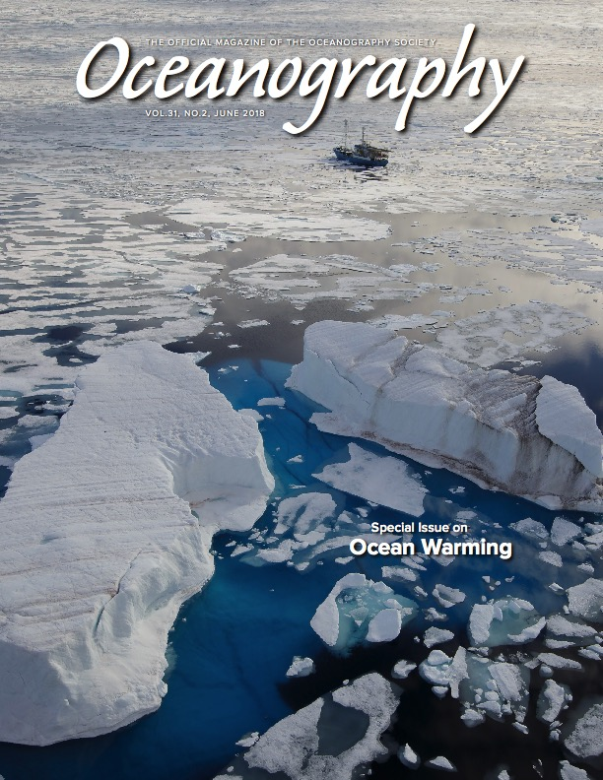
Introduction to the Special Issue on Ocean Warming
See https://tos.org/oceanography/issue/volume-31-issue-02
Reference: P. J. Durack, A. Sen Gupta and L. H. Smedsrud (2018) From the Guest Editors: Introduction to the Special Issue on Ocean Warming. Oceanography, 31 (2), 28-31. doi: 10.5670/oceanog.2018.226

