Slide 1
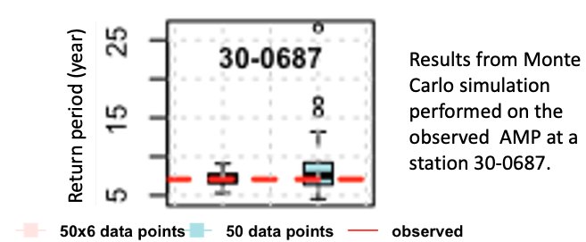
Pooling Data Improves Multimodel IDF Estimates over Median-Based IDF Estimates: Analysis over the Susquehanna and Florida
Top left Fig:
Bottom 3 Figs: PIF estimates of 24-h precipitation totals at the station 30-0687 in the bias-corrected historical and future simulations. Hist (historical). Shadings show 90% confidence intervals around the estimates (solid curves).
We proposed a method based upon pooling of model data to reduce uncertainty in multimodel intensity, duration, frequency (IDF)/ precipitation intensity-frequency (PIF) estimates.
Monte Carlo simulations with synthetic data show that return periods derived from pooled data have smaller biases and lesser uncertainty than those derived from ensembles of individual model data.
Intensity (mm/day)
Return period (years)
The approach identifies significant future changes at more stations compared to median-based PIF estimates.
When applied to the NA-CORDEX models, the analysis suggests that almost all stations over the Susquehanna and at least two-thirds of the stations over the Florida peninsula will observe significant increases in 24-h precipitation for 2–100-yr return periods.
Three-step procedure:
Evaluate performance of climate models in simulating the spatial and temporal variability of the observed annual maximum precipitation (AMP).
Bias-correct and pool historical and future AMP data of reasonably performing models.
Compute IDF estimates in a nonstationary framework from pooled historical and future model data.
Srivastava, A. K., Grotjahn, R., Ullrich, P. A., & Sadegh, M. (2021). Pooling Data Improves Multimodel IDF Estimates over Median-Based IDF Estimates: Analysis over the Susquehanna and Florida, Journal of Hydrometeorology, 22(4), 971-995. https://journals.ametsoc.org/view/journals/hydr/22/4/JHM-D-20-0180.1.xml

