Slide 1
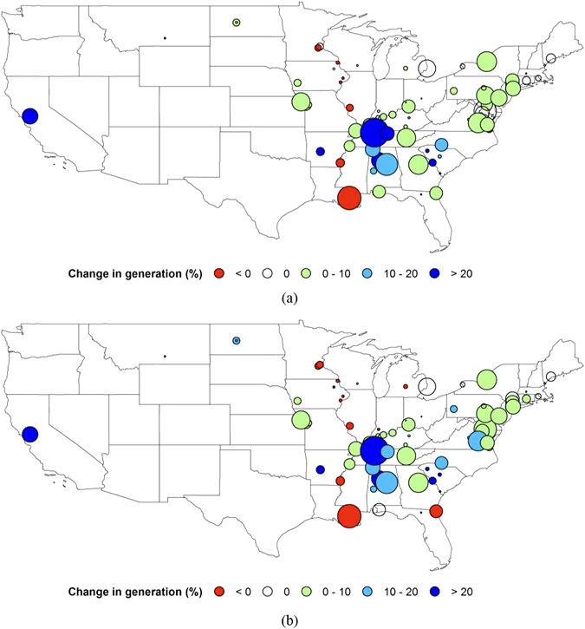
River Regulation Alleviates Thermoelectric Power Loss Induced by Warming
Objective
Quantify the impacts of water management on once-through cooled thermoelectric power generation in a warmer future and compare them to the impacts of emission control that reduce future stream temperatures
Approach
Use a state-of-the-art integrated water cycle model consisting of a land model, a streamflow and stream temperature model, and a water management model driven by scenarios of future climate and water demand
Use a thermoelectric power generation model to simulate the power losses under different scenarios
Impact
This study is the first to reveal that river regulation can curtail the loss of summer power plant usable capacity induced by warming in the future
This study further shows that the effect of flow regulation on power losses is comparable to that of reduced stream temperatures due to emission control
Changes in thermoelectric power plant capacity due to water management under two future emissions scenarios: (a) RCP4.5 during the 2040s and (b) RCP8.5 during the 2080s. The size of the circles represents power plant nameplate capacity.
X Zhang, H-Y Li, LR Leung, L Liu, MI Hejazi, BA Forman, and W Yigzaw. 2020. “River Regulation Alleviates the Impacts of Climate Change on U.S. Thermoelectricity Production,” Journal of Geophysical Research: Atmospheres 125: e2019JD031618.
DOI: 10.1029/2019JD031618
Notes:
http://www.pnnl.gov/science/highlights/highlights.asp?division=749

