Slide 1
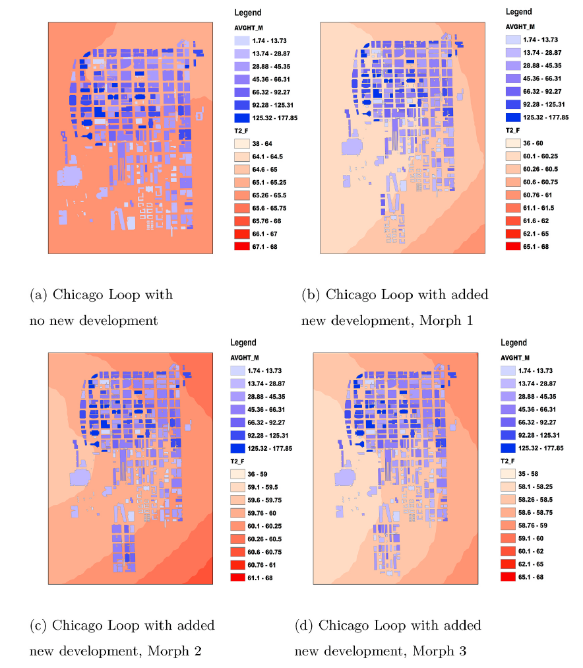
Impacts of the Morphology of New Neighborhoods on Microclimate and Building Energy Use
Objective
Demonstrate a process for creating and testing new neighborhood morphologies for their impact on local and regional meteorology within a two-way-coupled mesoscale weather model.
Approach
Five 1-year, four-domain nested meteorological simulations for 2015 were run using the Weather Research and Forecasting (WRF) model for two locations..
WRF-readable urban terrain inputs were generated using ORNL-produced shapefiles from LiDAR imagery and laser measurement and included in the simulations.
Future morphologies were generated using the concept of Urban Tissues, in which physical elements and relationships of the existing neighborhood are identified, subsetted, recombined for the new neighborhood.
Building-specific meteorological profiles were defined at 90m resolution and used to initialize each building in massively parallel EnergyPlus building energy simulations.
Impact
This work represents an important step towards quantifying and analyzing the relationships among climatic conditions, urban morphology, land cover, and energy use; and using these relationships to inform energy-efficient urban development and planning and prepares the way for assessing future microclimate and building energy consumption using global climate projections as boundary conditions, and incorporating impacts of population shifts and urbanization.
Comparison of July average 2m temperature in the Chicago Loop with four different morphological configurations shows the influence of the addition of each morphology on the microclimate, which affects the amount of building heating and cooling used in response.
Allen-Dumas, MR, Rose, AN, New, JR, Omitaomu, OA, Yuan, J, Branstetter, ML, Sylvester, LM, Seals, MB, Carvalhaes, TM, Adams, MB, Bhandari, MS, Shrestha, SS, Sanyal, J, Berres, AS, Kolosnaa, CP, Fu, KS, Kahl, AC (2020). Renewable and Sustainable Energy Reviews, 133 (2020) 110030.

